Slide 1
Assessment Record Updating Application (ARUA)
Find the application on the ODE secure district website:
Consolidated Collections > ARUA >
Assessment Transactional System 23-24
Find this presentation on the Assessment Transactional System page
Welcome!
Notes:
Welcome all; this is the webinar for the Assessment Record Updating Application, abbreviated ARUA, which replaced the functionality of the old Student Centered Staging application.
The purpose of this application is to provide a central location for district users to view, edit, and correct statewide assessment results that have been received by the Oregon Department of Education (ODE). You can find this application on the ODE secure district website.
The video recording and PowerPoint for this presentation are available on the Assessment Transactional System page on the ODE district website, linked on this slide.

Slide 2
Assessment Contacts
Assessment Data Owners
  Cindy Barrick (971-208-0480)
  Research Analyst, Accountability Reporting
  Bianca Llamas (971-208-0437)
  Research Analyst, Accountability Reporting
Regional ESD Partners
Notes:
Your assessment contacts include myself, Cindy Barrick, and Bianca Llamas, the data owners for this application.
Of course our Regional ESD Partners are always the first and best resource for all of you in the districts.

Slide 3
Agenda 1
Navigating the Application
Documentation
Notes:
In this presentation, I will be walking through the navigation of this application and how it’s designed to function; as we go through, I’ll try to highlight some of the new editing features; and then I’ll go over the supporting documentation that’s available and where to find it.

Slide 4
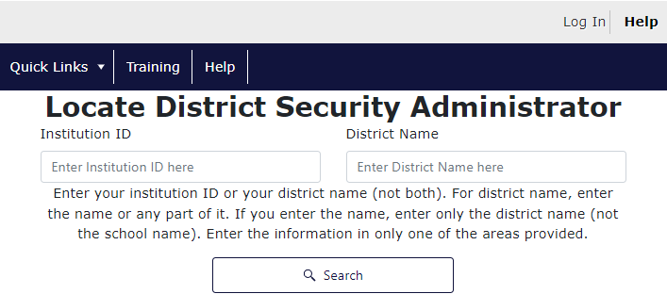
ODE District Website Central Login
Go to the ODE District secure website: https://odedistrict.oregon.gov/
Log in via Central Login – username and
password can be obtained by contacting your
District Security Administrator (DSA)
You can find your DSA here: https://district.ode.state.or.us/apps/login/searchSA.aspx
From Applications List, select ‘Consolidated Collections’
Notes:
Everything we’re going over today is located on the ODE district secure website, so you will need a central login account and permission from your District Security Administrator to access Consolidated Collections and the Assessment Transactional System collection.

Slide 5
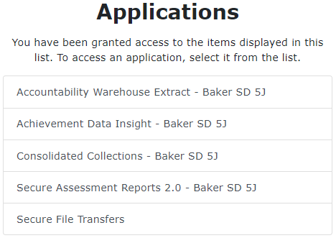

Consolidated Collections
Application is where?
Log in to Consolidated Collections on the ODE secure district website.
If you have permissions, you should see “ARUA” on the top menu bar between Staff Collections and Reports. Select ‘Assessment Transactional System’ for the current school year.
Notes:
You can find this application within the Consolidated Collections application, under the ARUA menu, by selecting Assessment Transactional System for the current school year.

Slide 6
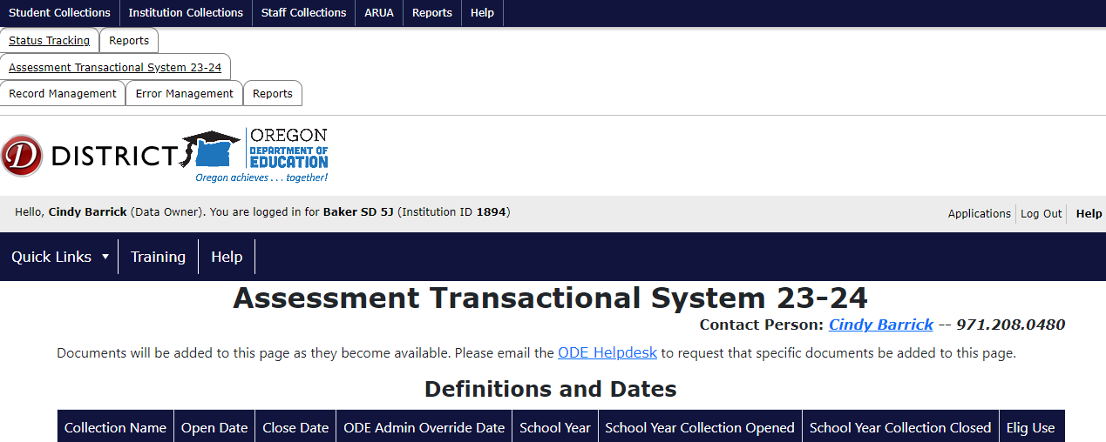
(ARUA) Landing Page
The landing page looks similar to a Schedule of Due Dates page, with Dates, Audience, and Documents.
The menu tabs are similar to other collections, with Record Management, Error Management, and Reports.
Notes:
And then you will arrive at the ARUA landing page. The current year collection will be the only one available, so you will only be able to view records for the current year and edit during the editing window.

Slide 7

(ARUA) Menu
Record Management
Error Management
Reports
Notes:
So you’ll notice that the main menu for this application looks very familiar if you’ve been using Consolidated Collections to submit data for student or staff collections: it has a Record Management section, an Error Management section, and a Reports section, and we’ll walk through each of these.

Slide 8

(ARUA) Record Management Menu
Record Management has four menu options:
  Lookup Posted Records
  Edit Posted Records
  File Upload
  Production Download
Notes:
In the Record Management menu, you have four options.
You can look up posted test records, if you just want to view them online;
you can edit individual records directly, by going into Edit Posted Records;
you can also download a file via Production Download; and make edits to multiple records, and then you can upload your files using the File Upload screen.

Slide 9
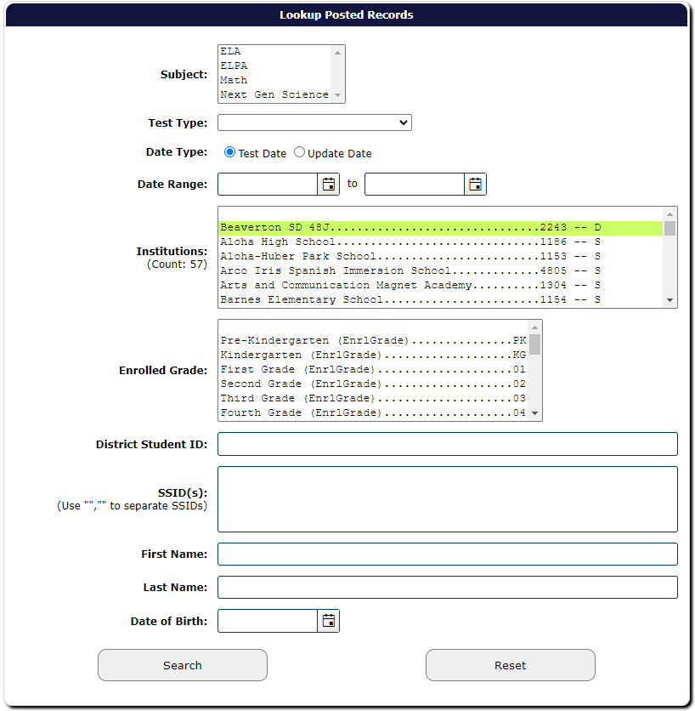
Lookup Posted Records / Edit Posted Records
Search screen has the same basic fields for selecting records:
  Subject, Test Type, Date, School, Grade, District Student ID, SSID(s), First Name, Last Name, and Date of Birth
Notes:
The search options are the same for the Lookup Posted Records, Edit Posted Records, and Production Download screens.
The search screen has the same basic fields that were available in Student Centered Staging, minus the advanced search options. So you can search by subject, test type, date, school, grade, district student ID, SSIDs (separated by commas), student name, and date of birth.

Slide 10
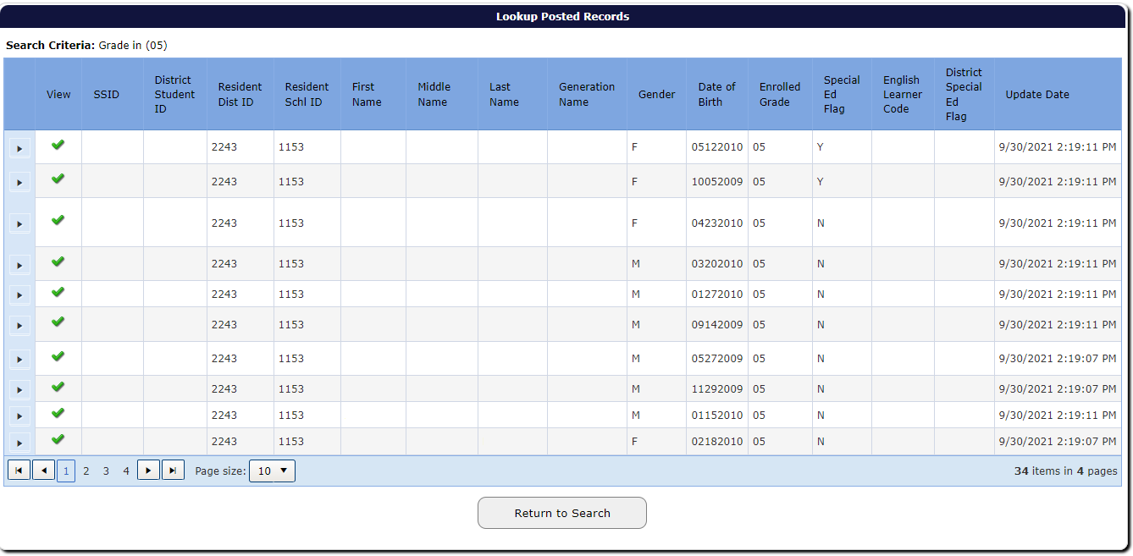
Student Search Results
Notes:
The main difference between the ARUA and the old Student Centered Staging is that the records are divided up into two sections: student demographics, and test information.
When you search for specific records, the search results will first show you a list of students that meet your criteria.
If you click on the green checkmark, you can see the student demographic and resident institution fields.
If you click on the arrow button to the left of the green checkmark, then you will see a list of all tests associated with that student, regardless of which subject was selected on the search screen.

Slide 11
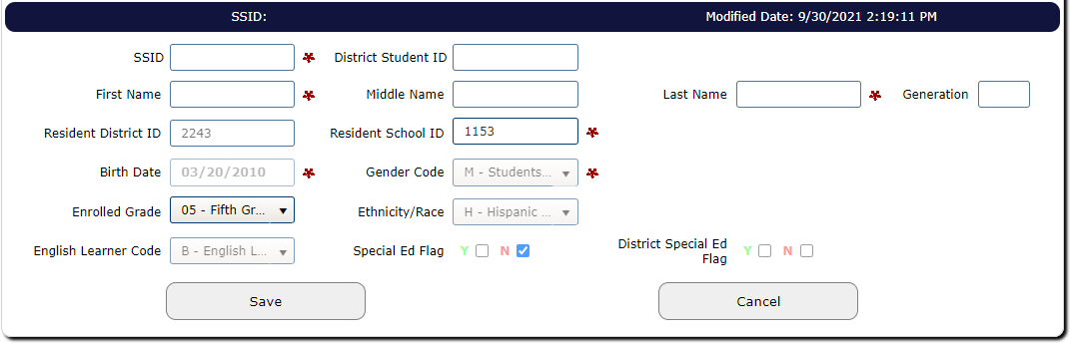
Student Demographics Screen
Notes:
So this is what the student demographics screen looks like after you click the green checkmark next to a student. The required fields, marked with asterisks, indicate the fields that must not be blank when a district user uploads a file (any blanks in these fields will cause an error).
The Enrolled Grade will only be editable between July 1 and the close of the editing window for the school year.

Slide 12
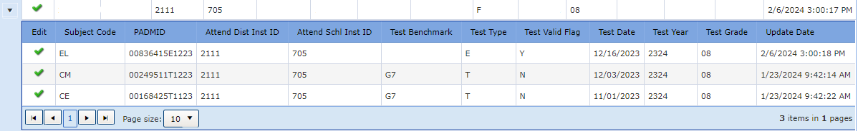
List of Tests associated with a student
Notes:
So after you click on the arrow button to the left of the green checkmark for the student, you get a list of all posted tests associated with that student. This list will display the subject code, PADMID, Attending district and school IDs, test benchmark, test type, test valid flag, test date and test year.
Then if you click the green checkmark next to one of the test records, you can see all the fields for that one test record.

Slide 13
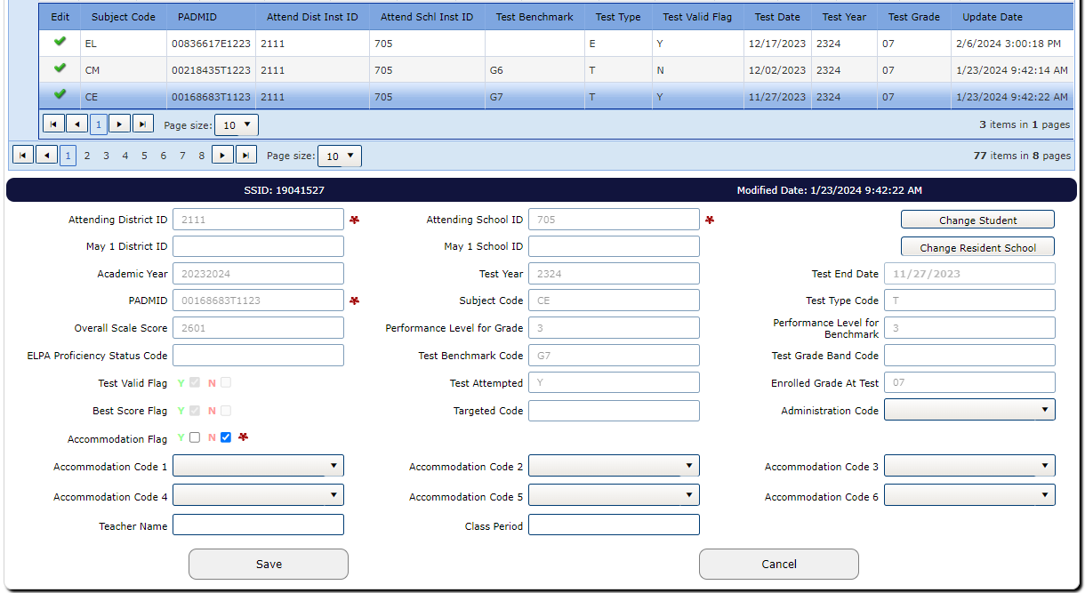
Editing One Test Record Online
Notes:
And this is the screen with all the test information, so it includes the PADMID, benchmark, score and performance levels; and then the administration code, accommodation codes, and the teacher name and class period are editable right here on the screen, as well as through a file upload.

Slide 14
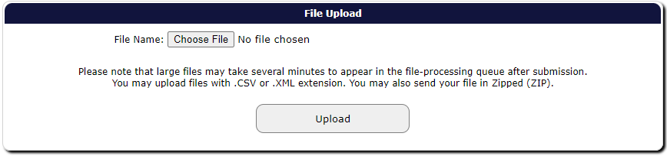
File Upload Screen
File layout:
  Assessment Transactional Format on the File Formats Home page
Notes:
If you need to upload a file, you can do so using the File Upload Screen, where you click the [Choose File] button to select your file, and then just click the [Upload] button. The file must be formatted according to the Assessment Transactional file layout, which is available on the File Formats Home page on the ODE District website.

Slide 15
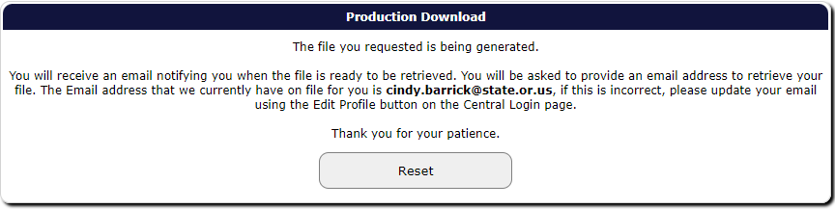
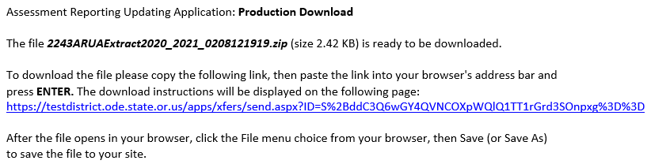
Production Download
Notes:
To download a file, go to the Production Download search screen, select the records you want using the available search criteria, and then click the [Submit] button to generate a CSV file, which will be emailed to the email address on file for the user.
A new feature in this application is that you can download (and upload) multiple subjects in one file, whereas the old system was limited to separate files for each subject.
It’s important to note: If you are going to edit and then re-upload the file, then you need to import the downloaded CSV file into Excel in order to preserve the formatting of some specific fields.

Slide 16
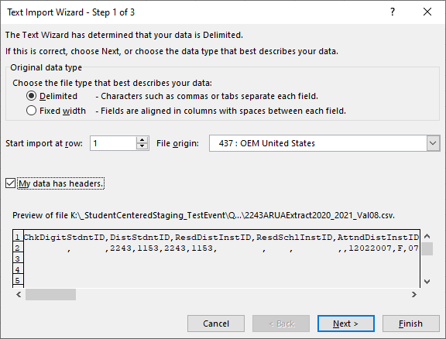
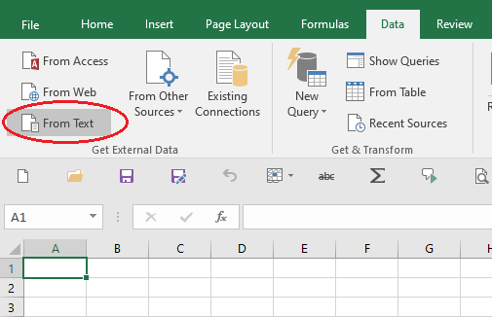
Import File to MS Excel
Notes:
Let me just take a minute to walk through the process of importing a CSV file into Excel. Open a blank new sheet, and from the Data menu, Get External Data section, click the ‘From Text’ button.
Select the file you wish to import, from the secure location where you saved it, and click the [Import] button.
Make sure the ‘Delimited’ radio button is selected and the box is checked for ‘My data has headers.’ Click the [Next >] button.

Slide 17
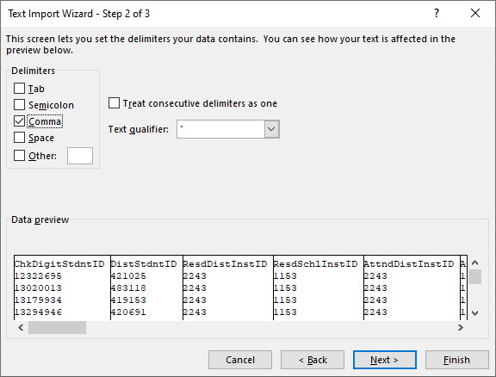
Import File to Excel (cont’d)
Notes:
Check the box for ‘Comma’ in the Delimiters section, and un-check all other boxes. Click the [Next >] button.

Slide 18
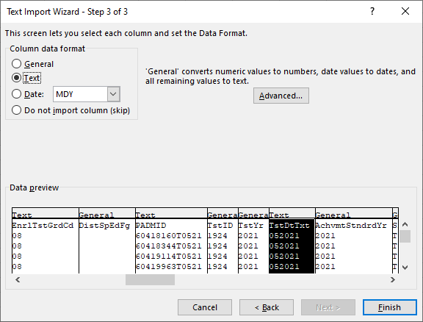
Import File to Excel – Format as Text
The following fields must be imported as text in order to preserve formatting and leading zeros:
  BirthDtTxt
  EnrlGrdCd
  EnrlTstGrdCd
  PADMID
  TstDtTxt
Notes:
In the Data Preview window, scroll across the fields and click on each column that needs to be imported as text (as listed here on this slide) and select the ‘Text’ radio button for each one.
Then click [Finish] and then [OK] to import the file. Save the file in a secure location with a file name of your choosing. This allows these five fields to be formatted properly, not converted automatically to numeric.

Slide 19
(ARUA) Error Management Menu
Error Management has six menu options:
  Review Queue
  Review Email
  Review District Errors (review errors from district files)
Review Vendor Errors (review errors from vendor files)
House Keeping
Download Errors
Notes:
So next we’ll go into the Error Management section of the application.
In the Error Management menu, you have six options. The main difference here between this application and other Consolidated Collections, is you have two Review Errors screens:
Review District Errors, which is where you review errors in files that a district user has uploaded, and Review Vendor Errors, which is where you review errors in vendor files as they come in, that need to be fixed by a district user in order for the records to post.
And then the other usual options in this section: Review Queue, Review Email, House Keeping, and Download Errors.

Slide 20
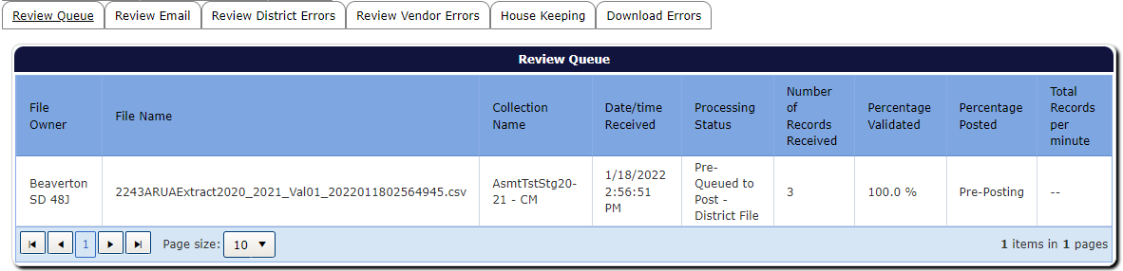
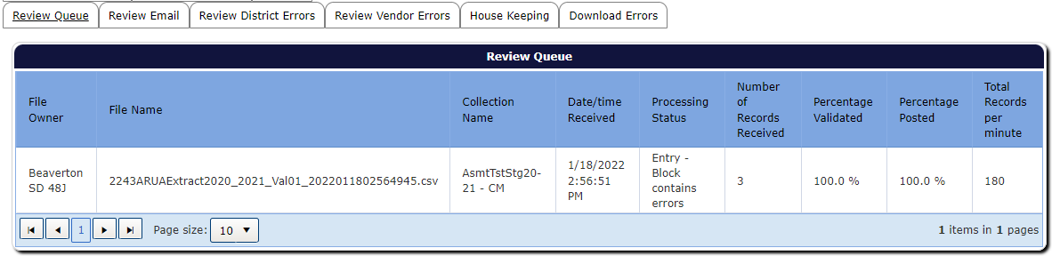
Review Queue
Notes:
After you’ve uploaded a file, you can Review the Queue, to see the progress of the file validation; it will initially say “Pre-Posting” while the file is being processed, and then when it’s finished, it will say 100% and show you the count of records received and whether the file contains errors.

Slide 21
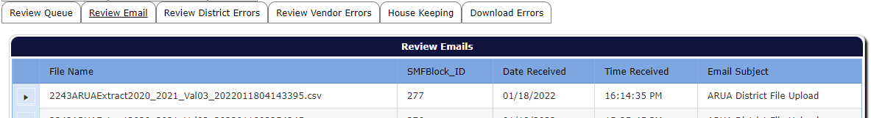
Review Email
Notes:
The Review Email screen is where you can see the contents of the email that was sent to the user who uploaded a file. Click the arrow button in the leftmost column to expand the display, for each file that’s been submitted.

Slide 22
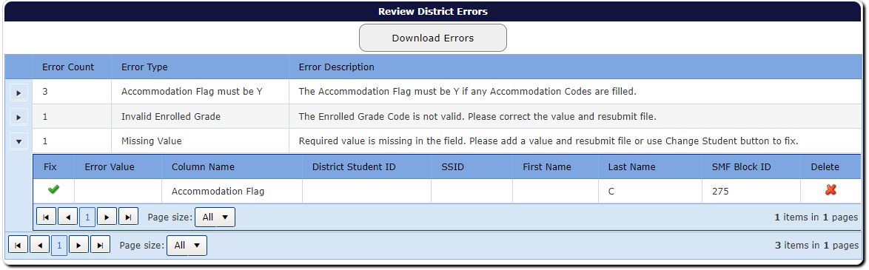
Review District Errors
Review errors from files uploaded by district users
Notes:
The Review District Errors screen allows the user to view and resolve any errors that may exist in files that were uploaded by a district user. Errors can be corrected online by clicking the leftmost arrow to expand the Error Category, then clicking the green checkmark in the Fix column. This will display the test record fields in a screen at the bottom of the webpage.

Slide 23
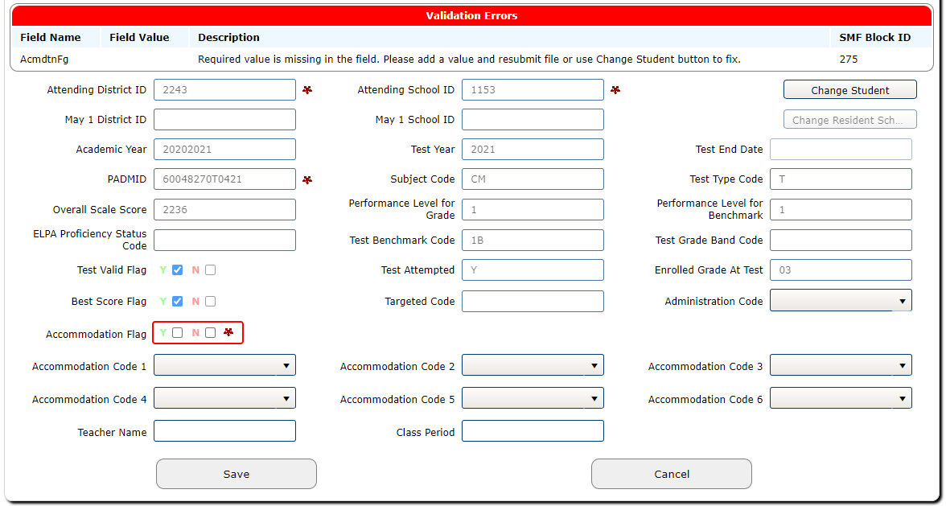
Validation Errors – Test Record Fields
Notes:
Review the error information listed at the top of the form in the Validation Errors section. The fields that are causing the validation errors are highlighted with a red border line. Make the necessary data corrections to resolve the listed error, then click the [Save] button to save the changes. If all the errors have been corrected, then a “Record Saved” message will be displayed at the top of the screen.
To leave without making any changes to the record, click the [Cancel] button.
If the fields causing the validation errors are student demographic fields, those can be fixed using one of the buttons in the right-hand corner of the screen (the Change Student or Change Resident School button), or by doing a File Upload.

Slide 24
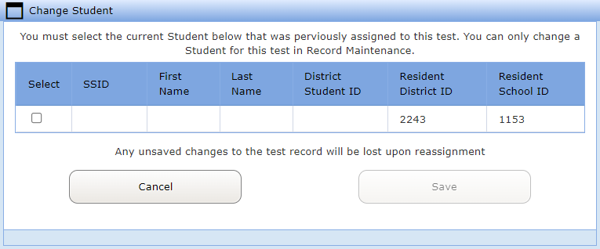
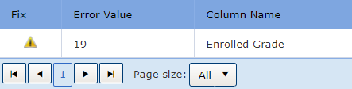
Student Demographic Errors
Use Change Student button to fix:
  SSID Merge
  Student Gender, Birthdate, Name
  SSID must match PADMID
Use Change Resident School button to select a different resident school
Invalid Enrolled Grade can only be fixed via File Upload
Notes:
The Change Student button is how you can fix errors that occurred because of an SSID merge or the fields used for matching students, such as the gender, birthdate, or name; or if the SSID of a record you’ve uploaded does not match the SSID that we currently have associated with the PADMID of the record you’re editing.
If a student’s test record belongs to a different resident school, you can use the Change Resident School button to associate a test record with a different resident school. That association of the student with the school has to already exist, either on the SSID record or on another test record for that student.
If you see a yellow exclamation point in the ‘Fix’ column, instead of a green checkmark, that means that the error can only be fixed via File Upload, so if you had a typo in the enrolled grade or lost a leading zero, you’ll need to fix that by re-uploading the file.

Slide 25
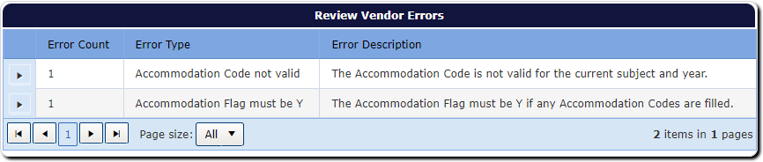
Review Vendor Errors
Review errors from vendor files
Notes:
The Review Vendor Errors screen displays errors that may exist in files submitted by a vendor, that need to be corrected by a district user before the records can post. Remember that only records that are error-free can be posted and included in the Collection for subsequent reporting. Any records still showing in Review Vendor Errors that have not been corrected online or through file uploads will not show up in Record Maintenance or a Production Download. These errors are corrected with the same process used for the Review District Errors screen.

Slide 26
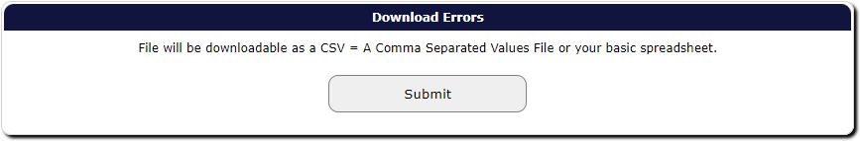
Download Errors
Notes:
If you have a lot of errors that you need to fix, you can download the errors in a file, correct them there, and then re-upload them back into the ARUA. All the errors will be included in one single download file, in CSV format, and in the Assessment Transactional File Layout.

Slide 27
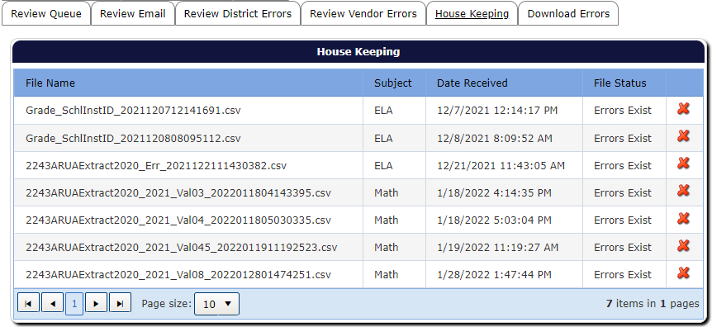
House Keeping
Notes:
The House Keeping screen displays a list of district-uploaded files with errors, and here you can delete an entire file if you need to. If you have multiple subjects in one file, each subject will appear in a separate row on this screen, and you’ll have to delete each subject row in order to delete the entire file.

Slide 28

(ARUA) Reports Menu
Reports has three menu options:
  Test Lookup Report
  Reference Report
  Participation Report
Notes:
Moving on to the Reports menu, there are the same three report options that we had in the old Student Centered Staging application: the Test Lookup Report, the Reference Report, and the Participation report.

Slide 29
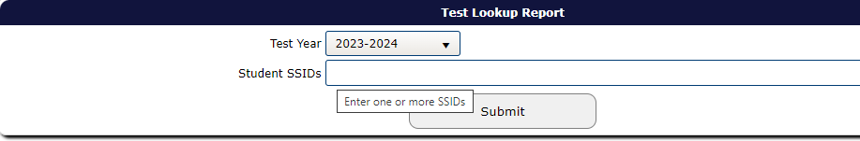
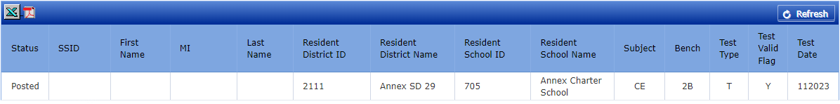
Test Lookup Report
Notes:
The Test Lookup report allows you to look up what tests a student has. You can select the year and type in the student’s SSID, or multiple SSIDs separated by commas; and click on the Submit button, and it will list all the tests we have for that student or students. You can see which subjects have been completed and where the student took the tests, so, regardless of where the tests were taken, it’ll show the district and school, and subjects. This is helpful if you are missing students, or if you have a student move into your district, you can look them up here to see if they have already taken a test in a subject and where they took it. There’s no score information on this report, but it’ll give you an idea if the student has a test or not for a certain subject.
And this report is available to download in both Excel and PDF formats. Please be careful, if you download this report, to keep it in a secure location and restrict access to it, since it has student SSIDs and names on it.

Slide 30
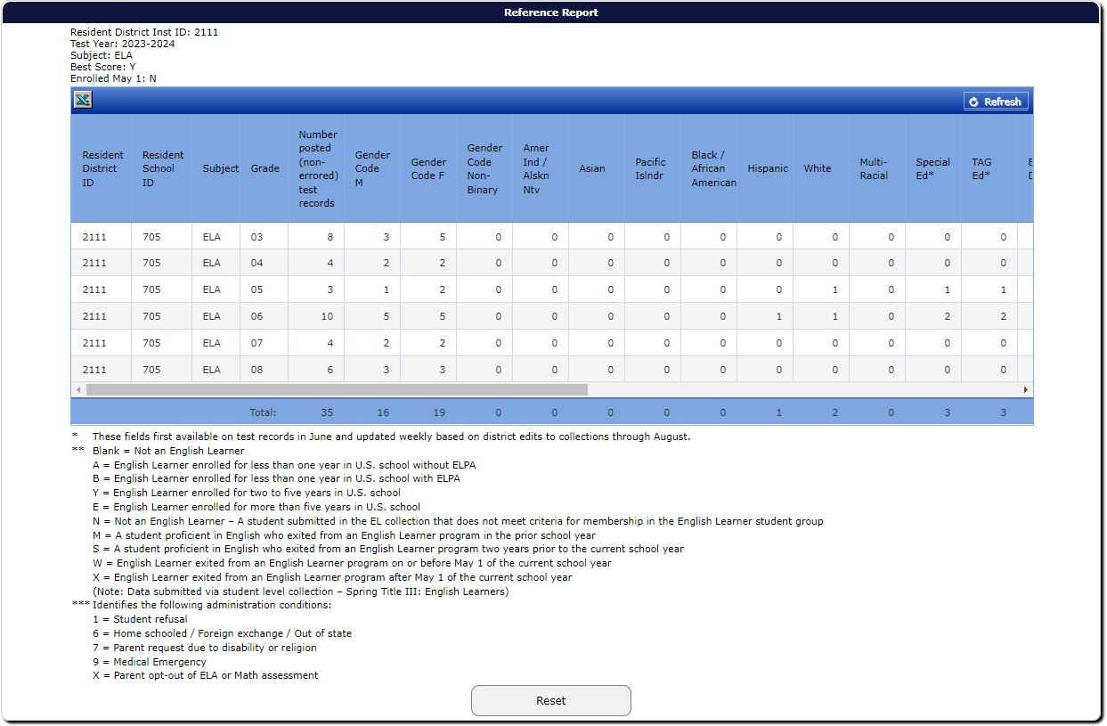
Reference Report
Notes:
The Reference Report will give you some basic counts of your demographic information, as well as a summary of program flags. This can be helpful if you want to take a look at how many students you have in each of those areas; and this report is broken down by subject, year, and grade, and the last column shows a count of how many records are in error.
There is a button in the upper left corner that you can click to download this report in a spreadsheet format. The downloaded file will include the notes on a separate tab in the file.

Slide 31
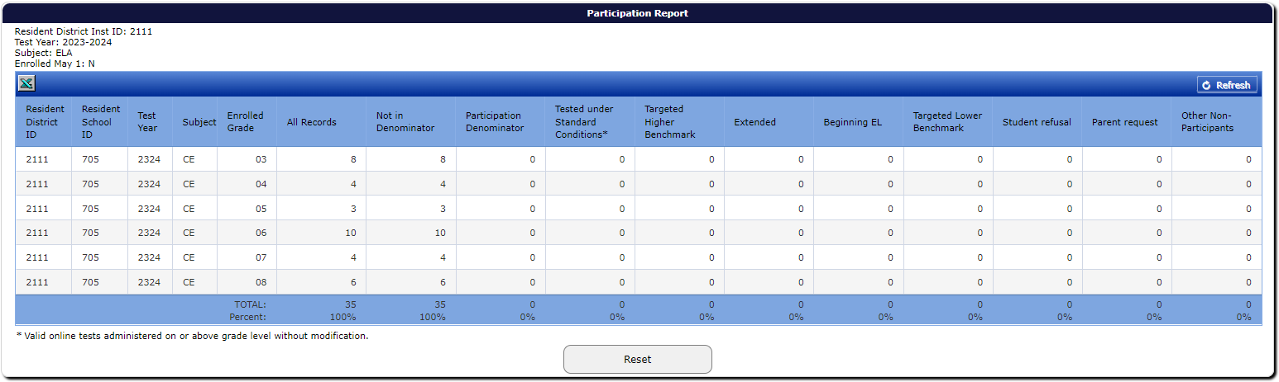
Participation Report
Note: All counts will be in the Not In Denominator column until processing begins.
Notes:
And the Participation report will contain summary information about how many participants and non-participants that you have. Please keep in mind that this won’t be useful until we start our processing for accountability reporting in the summer, the first week in June. At that point you can start to see your counts of participants by test type (standard and Extended); first-year or Beginning English Learners; and counts of non-participants. The processing runs weekly during the summer, so you’ll want to check again after records have been edited.

Slide 32
Agenda 2
Navigating the Application
Documentation
Notes:
Next I’ll talk about the documentation that’s available and where to find it.

Slide 33
Documentation
On the ODE district website:
  ARUA User Guide
  Assessment Applications
  Video Training
    Winter webinar – overview of applications and working with assessment data
    Spring webinar – accountability reports and how to validate assessment data
On the ODE public website:
  Student Assessment
    Each subject has its own page
    Test Administration has many resources
    Accessing Student Scores Online page
  Key Dates for Accountability and Reporting
Notes:
The documentation we currently have available includes the User Guide for this application, linked here on this slide, which can also be accessed under Additional Documents on the Assessment Transactional System page on the ODE district website.
Also, from the Training main page, there is a table that lists all the training webinars that are scheduled; and training materials for past webinars are on the Previous Trainings page. Typically for the assessment data, we have a winter webinar, which provides an overview of applications and working with assessment data, and then a spring webinar where we go over the accountability reports that use assessment data and how to validate them.
Over on the ODE public website, the Student Assessment page has a section for each subject; the Test Administration section has many resources for test coordinators and other interested parties, and the Accessing Student Scores Online page has information specific to the current school year.
And the Key Dates page has news and important dates that are updated weekly, as well as links to various schedules to help you keep track of what is due and when things are happening.

Slide 34
Thank You!
Notes:
This concludes the ARUA Walkthrough.
I want to say how much I appreciate all the time and effort you put into maintaining high quality data. We couldn’t do the data reporting that we do without everything that all of you contribute, so thank you.

