Slide 1
Abbreviated Day Application 2024-2025
September 18, 2024

Slide 2
Agenda
Purpose of Application
Application Features
Reporting Criteria
Data Entry and Record Management
Troubleshooting & FAQ
Demonstration:
Submitting & Editing Records
Verification
Production Downloads
Notes:
Cara
This is what we will be going over today.
We will go over the purpose of the collection, as well as the reporting criteria and features including who is to be reported and not reported.
We will also go over the data entry fields including new Program Reason Codes and a new monthly verification process.
Finally, we will provide a demonstration on how to submit and manage records, including uploading consent forms. We will also see how to verify records monthly and how to download available data in a table (.csv) format.

Slide 3
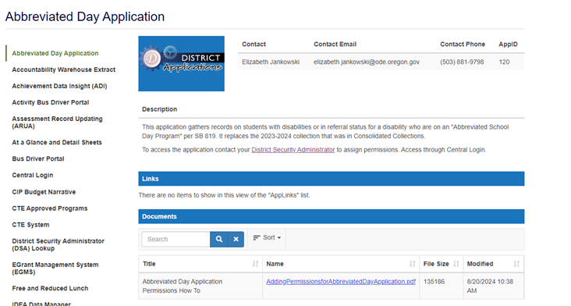
Abbreviated Day Application Web Page
Notes:
Cara
The Application page has a new weblink located under the Applications section of the District website.
A short instructional page about how to grant Application permissions is available on the new website. The Application User Manual will be posted soon. We will post the slides for this webinar at a later date.

Slide 4
Contact Information
Data Owner:
Elizabeth Jankowski, (503) 881-9798 or elizabeth.jankowski@ode.oregon.gov
Abbreviated School Day Program Research Analyst:
Cara McMurry, (503) 689-2783 or cara.mcmurry@ode.oregon.gov
Other Research Analysts on the Data Team:
Amanda Claycomb (503) 931-8003 or amanda.claycomb@ode.oregon.gov
Jackie McKim, (971) 240-0234 or jackie.mckim@ode.oregon.gov
Cynthia Garton, (503) 508-7492 or cynthia.garton@ode.oregon.gov
Maxwell Swope, (971) 208-0259 or maxwell.swope@ode.oregon.gov
Notes:
Cara
As you navigate the data collection, please reach out to me or Elizabeth Jankowski for assistance as individual issues or questions arise. We are here to help.
I am the new designated Research Analyst for the Abbreviated School Day Program. However, if I am unavailable, any of the other Research Analysts on the OESO Data Team can assist.

Slide 5
Purpose of Application

Slide 6
Purpose of the Application
Collect student level records who are on an Abbreviated School Day Program
This Application will provide the basic data elements needed and will be used to:
Help with tracking and monitoring per SB 819
Provide guidance and technical assistance
Notes:
Cara
The purpose of the Abbreviated Day collection is to collect student level records for those who are on an abbreviated school day program.
SB 81,9 signed into law last summer, created new provisions relating to abbreviated school day programs.
This data will be used for
Tracking and monitoring the use of Abbreviated School Day Program per SB 819, and
Providing guidance and technical assistance to districts and agencies.

Slide 7
Who Submits
Resident Districts
ODE Contractors/Partners responsible for reporting for ODE or Districts:
JDEP (ODE)
YCEP (ODE)
Hospital Programs (District)
LTCT (District)
Pediatric Nursing Facilities (Districts)
Notes:
Cara
Here are the districts and agencies required to submit data to this collection.

Slide 8
Abbreviated School Day Program means (per SB 819):
An education program in which the school district restricts access for a student with a disability to hours of instruction or educational services to less than the number of hours of instruction or educational services that are provided to the majority of other students who are in the same grade within the student’s resident school district, and
That results in a student with a disability having an abbreviated school day for more than 10 school days per school year.
Notes:
Cara
An Abbreviated School Day Program as defined by Senate Bill 819 has two parts:
One, It is an educational program in which the school district restricts access for a student with a disability to hours of instruction or educational services to less than the number of hours of instruction or educational services that are provided to the majority of other students who are in the same grade within the student’s resident school district,
If the first criteria is met, then the student is considered in an abbreviated school day program IF the number of abbreviated school days exceeds 10 days. On day 11 the student is considered on an Abbreviated School Day Program.

Slide 9
Criteria for Reporting a Record
When a student with an IEP, 504 plan, or referred for an evaluation for Special Education or Section 504, is on an Abbreviated School Day for more than 10 school days per school year
Record(s) become reportable on day 11
Days are cumulative!
Notes:
Cara
The criteria for reporting a record:
When a student with an IEP, 504 plan or referral for an evaluation for Special Education or Section 504, is on an abbreviated school day for more than 10 school days per school year
A record(s) becomes reportable when it reaches day11.
The count of days is cumulative! For example, 11 school days in a row or a total of 11 days accumulated throughout the school year.
Info for presenter use ONLY:
(see Sec 4. (e)
At least once every 30 calendar days during the school year, inform the Department
of Education about the student’s abbreviated school day program placement, including:
(A) The grade level of the student;
(B) The number of hours of instruction and educational services the school district is
scheduled to provide to the student each week;
(C) The date the student began the abbreviated school day program; and
(D) The date by which the student is expected to receive meaningful access to the same
number of hours of instruction and educational services that are provided to the majority
of other students who are in the same grade within the student’s resident school district.

Slide 10
When to Report
Throughout the year AND
As soon as possible (the same day or next day is best!)
Data collection is on-going. No open or close dates.
Notes:
Cara
Report all records that meet the criteria from July 1 to June 30.
The collection is open year around, so you will report records meeting the criteria throughout the year.
When should you report the records? As soon as possible. It is best to do it the same day or the next day while it is still fresh on everyone’s mind. This is not a collection with open and close dates, thus you can report year-round and are encouraged to do so.

Slide 11
Who is Not Reported
Home schooled
Parent Placed Private Schools
Excluded from or limited access due to court order
Component of discipline imposed
Exposure to disease
Public health emergency, i.e., restricted access or school closures as a result
Notes:
Cara
These are the types of students that Districts are not required to report.

Slide 12
Application Features

Slide 13
Abbreviated Day Application Features
Add Program data
Edit Program details
Upload and track multiple Parent Consent Forms
No File Upload option
Monthly verification of data
Production Downloads
Notes:
Cara
Last year this data was collected via Consolidated Collections. This year it has its own Application with different, but similar features.
Different from last year is the ability to edit a record after its creation. The data that CANNOT be edited and should be CAREFULLY entered is the program start date and the initial parental consent date. The process of deleting records is cumbersome and requires a ticket to ODE, so please take care when entering these data.
As open records from the previous school year, 2023-2024, were moved into this new Application, there will not be a need to upload numerous records at once. For this reason, given the burden of developing a file upload option, you will only be able to input a single submission at a time. You will, however, be able to upload unlimited consent document to the student’s record.
New to this data is the implementation of monthly verifications, which I will discuss later in this presentation.

Slide 14
Abbreviated Day Application Features – Editable fields
This year, several fields will be editable
Program Reason Code Notice Provided to Parent Disability Status Attending District ID Resident District ID Attending School ID Resident School ID | Latest IEP Date Special Education Primary Disability Date Notice Signed by Parent Program Reason Comment Weekly Minutes for Grade (Bell to Bell) Date Expected to Return to Full Day
Notes:
Cara
As I mentioned, several fields are editable after the creation of a student record. This includes the above fields, which are denoted with a red asterisk on the webpage. I will demonstrate this at the end of this presentation.

Slide 15
Abbreviated Day Application Features – Stop Date
When the abbreviated day program ends:
Enter the Abbreviated School Day Program Stop Date
No fields will be editable thereafter
If a student is placed on an Abbreviated School Day Program later in the school year, enter a new record
At this time, deletion of records must be done via ODE. Contact the Research Analyst to delete a record.
Notes:
Cara
Once a student’s program ends, enter the date of their last day on the program in the program stop date and select a program stop reason, a new field this year.
As I mentioned before, record deletion may only be performed by ODE. To delete a record, please contact me, the Research Analyst, to submit a ticket on your behalf.

Slide 16
Program Stop Reason Codes
Code | Name
01 | Returned to full-time instruction and educational services
02 | Moved out of District
03 | Dropped out of school
04 | No longer in Special Education
05 | No longer on a 504 Plan
06 | No longer in referral status (not eligible for IEP)
07 | No longer in referral status (not eligible for 504)
08 | Graduated with Regular Diploma
09 | Received Modified Diploma, no longer in school
10 | Received Extended Diploma or Certificate of Attendance, no longer in school
Notes:
Cara
Here is a list of the new program stop reason codes available currently. I will go over these in more detail later in the presentation.

Slide 17
Abbreviated Day Application Features – Open Records
Only one “open” record allowed per student in school year
Students can have multiple records reported
Only one with a BLANK Abbreviated School Day Program Stop Date
Notes:
Cara
You may remember last year that it was possible to enter multiple records for a student, but that they had to be entered chronologically.
This year you will get a warning if you attempt to create a record for a student with an open program (no program stop date).
The warning message will ask if you would like to end the program for the open record or create a historical record. I will demonstrate this after this presentation.

Slide 18
Reporting Criteria

Slide 19
More on When a Record Become Reportable
If Count of Days is 11 Consecutive Days:
Report the record
Day 1, not Day 11, is the Abbreviated School Day Program Start Date
If Count of Days is 11 Cumulative Days:
Report multiple records, one for each instance leading up to a count of 11 days total
Notes:
Cara
As it was last year, a student’s record becomes reportable when they have been on an Abbreviated Day Program for 11 consecutive or cumulative days.
The start date is the first date that the student was on a program.
This includes 11 incidents of 1 day of a program at different times.

Slide 20
Example: If Count of Days are Consecutive
Login and enter the record
Enter Abbreviated School Day Program Start Date
This is the date the student started on an abbreviated school day, not day 11
Enter all other data except….
Leave Abbreviated School Day Program Stop Date blank if student is still on an abbreviated school day program
Notes:
Cara
Here is an example of how to report when the count of days are consecutive:
Login and enter the record
Enter Program Start Date
This is the date the student started on an abbreviated school day, not day 11
Enter all other data except….
Leave Program Stop Date blank if student is still on an abbreviated school day program
We will demo this later.

Slide 21
Example: If Count of Days are Cumulative
Record Number 1:
Enter Day 1, not Day 11, as the Abbreviated School Day Program Start Date
Enter Abbreviated School Day Program Stop Date
Record Number 2:
Enter date student was again placed on an Abbreviated School Day Program
Leave Abbreviated School Day Program Stop Date blank if student is still on an Abbreviated School Day Program
Notes:
Cara
Here is an example of how to report when the count of days are cumulative:
Record Number 1:
Enter Day 1, not Day 11, as the Program Start Date
Enter Program Stop Date
Record Number 2:
Enter date student was again placed on an abbreviated school day
Leave Abbreviated School Day Program Stop Date blank if student is still on an abbreviated school day program.
It is possible for a student to have 2 or more records when the count of days are cumulative until reaching day number 11. You will enter each of these records, ending with the most current record. Leave the Program Stop Date blank if the student is still on an abbreviated day program.
We will also demo this later

Slide 22
Data Entry and Record Management

Slide 23
Data Entry Fields – Dates
Program Start Date (Required)
Enter the date the student started on an abbreviated school day
This is Day 1, not Day 11 for each instance
Date Expected to Return to Full Day (Required) Date student is expected to not be on an Abbreviated Day Program
Notes:
Cara
Next we well go over the Data Entry fields specific to the collection.
Program Start Date
Enter the date the student started on an abbreviated school day.
The start date is day one, not day 11 for each instance
Date Expected to Return to Full Day
This is the date the student is expected to return to a full school day.

Slide 24
Data Entry Fields – Weekly Minutes
Student’s Weekly Instruction and Service Minutes (Required) The weekly instructional and educational service minutes provided to the student
Weekly minutes for grade (Bell to Bell) (Required) Weekly minutes available to other students in the same grade at the Resident District
Notes:
Cara
Student’s Weekly Instruction and Service Minutes
This is the total weekly instructional and educational service minutes provided to the student, that is less than the total weekly instructional and educational service minutes provided to other students in the same grade in the resident district (for comparison, see Weekly minutes available to other students in the same grade at the Resident District)
Weekly minutes for grade (Bell-to-Bell)
This is the total weekly instructional and educational service minutes provided to other students in the same grade in the resident district, i.e., the total bell to bell minutes for the week.

Slide 25
Data Entry Fields – Program Reason
Program Reason Code (Required)
The code indicating the reason the student is on an Abbreviated School Day Program
Program Reason Comment
Required if Code 06 is selected
Be concise but brief (50 characters)
Notes:
Cara
The program reason codes have changed this year, as I mentioned. We will look at those changes momentarily.
Remember that a comment is required when 6 – Other is selected.
Please be brief and concise. The field is limited to 50 characters.
ODE may ask you to recode to an existing code if the comment indicates it fits under one of them.

Slide 26
Program Start Reason Codes
Code | Name | Description
01 | Social/Emotional/Behavioral Needs | To help the student meet their IEP or 504 goals related to behavior
02 | Medical Needs | To help students meet their medically related needs
06 | Other | Student is on an abbreviated school day program for other reason detailed in comment
07 | Adult Transition Needs | Student’s transition plan does not include a full-day schedule
08 | Charter School | Parental choice for child to attend charter school whose instructional minutes are less than sponsoring district
09 | Virtual Asynchronous Instruction | Child attends instructional model with components of asynchronous instruction
10 | Special School or Program | Team decision for child to attend special school or program where meaningful access is less than the comparison group
11 | Virtual Public Charter School | Virtual Public Charter School / Parental choice for child to attend a Virtual Public Charter School as recognized by ORS #338
Notes:
Cara
Read through codes
* Note distinctions between 8 and 10: parent choice vs team decision
Some codes have been removed this year, like reason code 5, “Court-ordered,” which became exempt with SB 1558 in March this spring.
Some codes have been renamed to better depict the data they capture.
Some codes have been added as we reviewed last year’s reason codes selected such as reason codes 8 through 11. This list of codes is included in the new Abbreviated Day User Manual online, the link to which we have shared at the top of the chat.
With regards to Code 6:
Other should only be used when the situation does not fall under codes 1 through 11. If you are not sure which code best fits your student’s situation, please call or email us. We are here to help!
This summer we reviewed all reason comments to determine what new codes were needed this year. We reviewed over 400 records with code “06 Other” selected. Some of these fit better into other categories, so please make sure your reason is not already listed.

Slide 27
Data Entry Fields – Notice to Parent
Notice Provided to Parent (Required)
Required information provided in writing (SB 819,Sec.4 (1-3))
Date Notice Signed by Parent (Required) The date the district/agency obtained required parental signature of acknowledgement
Notes:
Cara
Notice Provided to Parent
Yes/No Flag that indicates district provided the parent of the student written notice regarding the district’s legal requirements for an Abbreviated School Day Program per ORS 343.161(4).
Date Notice Signed by Parent
Date district obtained required parental signature of acknowledgement of receipt of required Abbreviated School Day Program Information per ORS 343.161(4).

Slide 28
Data Entry Fields – Parent Consent
Date of Initial Parent Consent (Required) Date parent signed consent
Latest Parent Consent Form (PDF file) Upload field for Signed Consent and Acknowledgement of receipt of program information
Steps to uploading:
Browse and select file to be uploaded
Once selected the file uploads
Click “Reset” if wrong file selected
CAUTION! When clicking the Save button at bottom of record
If wrong PDF uploaded, it cannot be deleted
Fix is to immediately use Select File and upload the correct file, then click Save
Notes:
Cara
Date of Initial Parent Consent
The date parent signed required consent to place student on an Abbreviated School Day Program per SB 819.
Latest Parent Consent Form
The latest paperwork associated with the Abbreviated School Day Program pertaining to the Signed Parent Consent and Acknowledgement of receipt of program information. Must be a PDF.
I have listed the steps here, but we will go over these in the demonstration later.

Slide 29
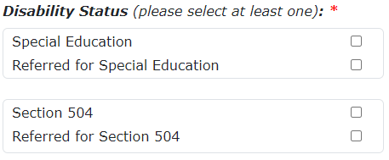
Data Entry Fields – Disability Status
These fields must be accurate. Check them every time a new record is entered!
Disability Status (Required)
Responses to these matter! This lets ODE know if the student is on an IEP or 504 plan, both or has been referred for either
Notes:
Cara
Disability status looks a bit different this year, as you can see. This year there are two sets of check boxes for Special Education and for Section 504 plans. Last year we asked that you click on ‘N’ for both Special Education and 504 flags to indicate that a student was in referral. This year we have a box for both Special Education and for 504 referrals. Please choose one from at least one set. Remember that a student can be on both an IEP and a 504 plan at once, so it is possible to select one from each group.

Slide 30
Data Entry Fields – Critical Fields to Check
Special Education Primary Disability
Select the primary special education disability from the drop-down list if the Special Education box is checked. If the Special Education box is not checked, select 00-Not Applicable.
Last IEP Date
The date that the student’s most recent Individual Education Plan was completed. This field is required if the Special Education box is checked.

Slide 31
Data Entry Fields – Program Stop
Program Stop Date
The date the student was last on an Abbreviated School Day Program. Leave blank if student is still on an Abbreviated School Day Program.
Program Stop Reason
The reason for which the student’s Abbreviated School Day Program was stopped. Leave blank if student is still on an Abbreviated School Day Program.
Notes:
Cara
New this year is the Program Stop Reason. Let’s take a closer look at those options again.

Slide 32
More on Program Stop Date
Enter the Stop Date when:
Student is no longer on an Abbreviated School Day Program
Student moves out of state or to another resident district
Student graduates with a regular high school diploma
Student returns to regular education
No longer in Special Education or on 504 Plan
Student referred for an initial evaluation for Special Education or 504
When evaluation complete and found not eligible

Slide 33
Stop Reason Codes – New!
Code | Name
01 | Returned to full-time instruction and educational services
02 | Moved out of District
03 | Dropped out of school
04 | No longer in Special Education
05 | No longer on a 504 Plan
06 | No longer in referral status (not eligible for IEP)
07 | No longer in referral status (not eligible for 504)
08 | Graduated with Regular Diploma
09 | Received Modified Diploma, no longer in school
10 | Received Extended Diploma or Certificate of Attendance, no longer in school
Notes:
Cara
This field is new, as I mentioned. These codes are to be used in the same way the Program Reason Codes are used. Select the code that best fits the student’s program stop reason. Leave this, along with the program stop date blank if the student is still on an Abbreviated School Day Program.

Slide 34
Multiple Records During the same School Year
Students may only have one “Open” record during the reporting period, or one record without a Program Stop Date
Students can have multiple records with a Program Stop Date.
Notes:
Cara
A student may have more than one record in the Application. This means that a student has multiple records with dates in the Program Stop Date field. I will demonstrate this later.

Slide 35
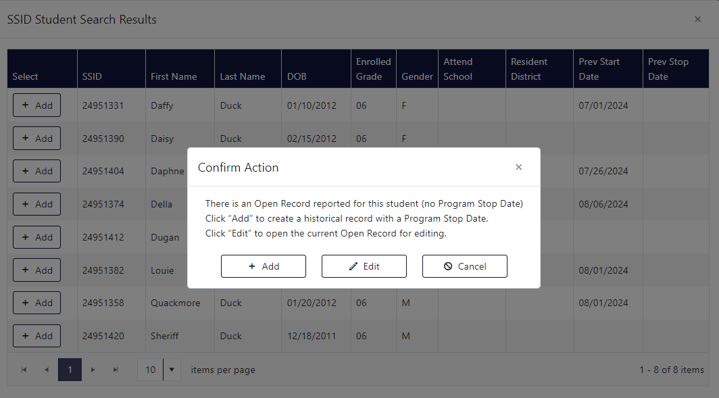
Multiple Records Confirmation
Notes:
Cara
This year the Application will ask you to Add a new record or Edit an existing record for a student with an “open” record. You can see in this window that Daffy, Daphne, Della, Louie, and Quackmore all have program start dates, but no program stop dates. These are examples of open records.

Slide 36
Monthly Verification
Verification is required at the end of each month. ODE cannot consider the monthly submission complete until the submitting district verifies it as complete. All districts are required to complete the verification process on the Reports tab.
You can expect a communication by email or phone from ODE if your district has not verified their data by the beginning of the month.
A demonstration of how to verify will be provided in this training.
Notes:
Cara
This is the process by which you can expect notifications from ODE regarding monthly verifications of your district’s data. Note that October will be our first month doing monthly verifications, so we anticipate some learning curves both for you and for us.

Slide 37
Troubleshooting & FAQ

Slide 38
Reason Codes: “Other”
Please only use this code when other codes absolutely do not describe the situation of the student in question.
Last year we had over 400 “Other” options selected, which we had to review and place in appropriate existing codes.
Notes:
Cara
We saw a lot of instances where a student was coded “Other” but in the comment field something like “medical” was added. These students should have been coded as “1”.
It is absolutely okay to use “Other” if your student doesn’t fit a code. If you are unsure about the reason code, please don’t hesitate to contact the Research Analyst or the Data Owner.
We hope to eliminate “Other” in the future, but for now are keeping it to capture anything not specified in the current list.

Slide 39
Deleting records
To delete a record, please contact the Research Analyst to submit a ticket to ODE on your behalf.
Records cannot be deleted by district staff.
Notes:
Cara
For now, there is no option to delete records on the district level.
To delete a record, please contact the Research Analyst of the Data Owner who will submit a ticket on your behalf.
The process is cumbersome. Please be very careful when entering data. Make sure you do not enter any start dates or consent dates incorrectly as these are not editable fields.
Different from last year is the ability to edit a record after its creation. The data that CANNOT be edited and should be CAREFULLY entered is the program start date and the initial parental consent date. The process of deleting records is cumbersome and requires a ticket to ODE, so please take care when entering these data.
We need more time to program this feature so it operates optimally. We will be adding this later on. This is all the information I have at this time
As open records from the previous school year, 2023-2024, were moved into this new Application, there will not be a need to upload numerous records at once. For this reason, given the burden of developing a file upload option, you will only be able to input a single submission at a time. You will, however, be able to upload unlimited consent document to the student’s record.

Slide 40
Application Demonstration

Slide 41
Thank YOU all so much for YOUR excellent work! We could not produce accurate data without YOUR Help!
Please reach out to any of us with further questions:
Data Owner:
Elizabeth Jankowski, (503) 881-9798 or elizabeth.jankowski@ode.oregon.gov
Abbreviated School Day Program Research Analyst:
Cara McMurry, (503) 689-2783 or cara.mcmurry@ode.oregon.gov
Other Research Analysts at ODE:
Amanda Claycomb (503) 931-8003 or amanda.claycomb@ode.oregon.gov
Jackie McKim, (971) 240-0234 or jackie.mckim@ode.oregon.gov
Cynthia Garton, (503) 508-7492 or cynthia.garton@ode.oregon.gov
Maxwell Swope, (971) 208-0259 or maxwell.swope@ode.oregon.gov

