Slide 1
How to Navigate Achievement Data Insight (ADI)
Stand Alone Training
March 2024
Oregon Department of Education (ODE)

Slide 2
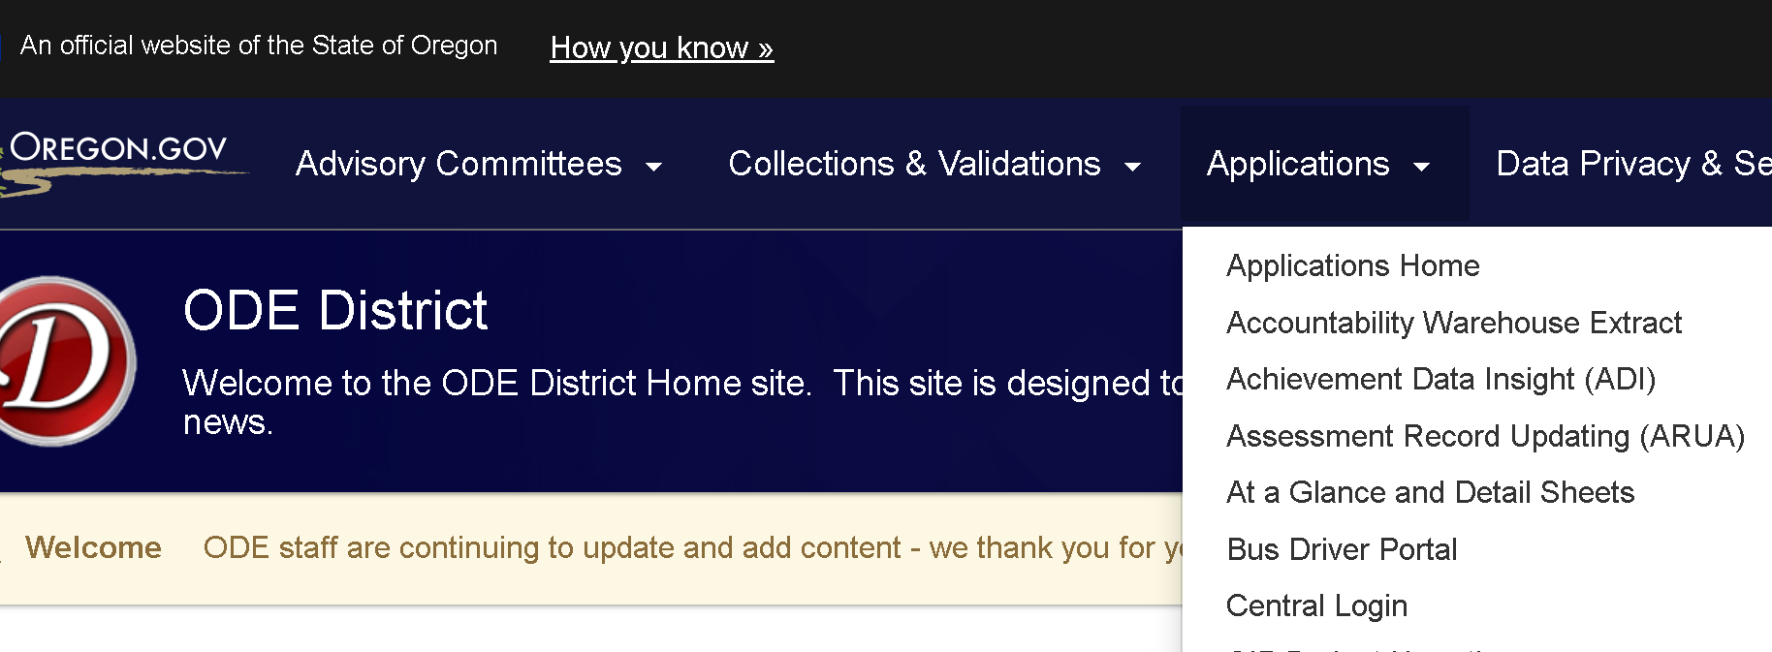
Where to find this video
https://odedistrict.oregon.gov/Applications/Pages/adi.aspx

Slide 3
About Us
The Oregon Department of Education works in partnership with school districts, education service districts and community partners to foster equity and excellence for every learner;
Together, we serve over 552,380* K-12 students and support 86,915* school employees, including teachers, administrators and classified staff;
We believe every student should have access to a high-quality, well-rounded learning experience; and
We work to ensure every student in Oregon graduates with a plan for their future.
*Data from Fall 2022

Slide 4

Who We Serve
552,380 Students
“My vision is to make sure every child in Oregon is successful and has a safe place to receive a high-quality public education. I’ve seen firsthand how a positive student-teacher relationship can set a child on a successful path for the rest of their life. When we collaborate and build partnerships with students, educators and families we can advance equity and lead all students toward success.”
- Dr. Charlene Williams
More than 340 languages spoken
86,915 Educators
Staff of Color
13.0% of Teachers
13.8% of Administrators
18.8% of Counselors
23.9% of Educational Assistants
197 Districts
1,270 Schools
131 Charter Schools
19 Education Service Districts

Slide 5
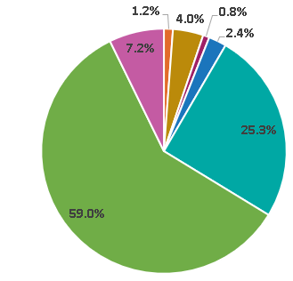
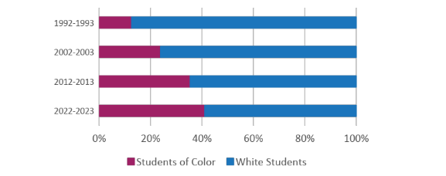
Who We Serve
Race and Ethnicity†
American Indian/ Alaska Native: 1.2%
Asian: 4.0%
Native Hawaiian/ Pacific Islander: 0.8%
Black/African American: 2.4%
Hispanic/Latino: 25.3%
White: 59.0%
Multi-Racial: 7.2%
Student Demographics
Economically Disadvantaged: 64%
Ever English Learners: 18%
Unhoused/homeless: 4%
Mobile Students: 11.7%
Students with Disabilities: 16%
Lesbian, gay, bisexual, queer, something else, or questioning*: 28.9%
Transgender, gender expansive, or unsure*: 12%
Oregon's Increasing Diversity
Notes:
Please note:
* Sexual Orientation and Gender Identity demographic data comes from the 2022 Oregon Student Health Survey, voluntarily taken by 6th, 8th, and 11th grade students in Oregon.
† “Student demographic data reported using the federally defined race/ethnicity groups. Federal reporting guidelines require states to report students who identify as Hispanic or Latino/a/x as such, even if the student also holds other racial identities. Similarly, if a student does not identify as Hispanic or Latino/a/x and holds more than one racial identity, under federal reporting guidelines, that student is categorized as Multiracial.” (ODE Report Card 2021-22, pg. 17)

Slide 6
Equity
Education equity is the equitable implementation of policy, practices, procedures, and legislation that translates into resource allocation, education rigor, and opportunities for historically and currently marginalized youth, students, and families including civil rights protected classes. This means the restructuring and dismantling of systems and institutions that create the dichotomy of beneficiaries and the oppressed and marginalized.

Slide 7
Terminology: Validation
ADI contains two collections (At-A-Glance Narrative and Special Education At-A-Glance Narrative)
Everything else is a validation, meaning that the data cannot be edited directly in the application.
Validations enable the secure viewing and previewing of unsuppressed data. They represent unique data sets derived from your original source data.
Validation of your data means you have reviewed all the data and confirmed that they are accurate.
Your data will be published in ODE reporting after the validation closes and the embargo period ends.

Slide 8
Validations
Graduation and Dropout:
Trainings in October
Fall Membership:
1st period ADM training in September
Staff FTE and Ethnicity:
Training in March
Institutions for Accountability Reporting:
Training in April
Ninth Grade On-Track:
Training in late April/early May
Assessment Results:
Training in May
Student Enrollment, Staff Turnover, Student Mobility, Regular Attenders:
Training in late May/early June
At-A-Glance profiles and details:
Training in June & July
Class Size:
Training in July

Slide 9
ADI Terminology
Refresh: The process by which a validation is updated to reflect a more current version of the underlying data used to produce it.
Data Owner: The ODE staff member who is primarily responsible for the collection, validation, or report.

Slide 10
Aggregation vs Disaggregation (Summary Tab)
Aggregation: Data about clusters or groups, such as counts, averages, medians, or percentages
Disaggregation: Aggregations for specific student groups, such as race/ethnicity or gender

Slide 11
Other Terms: Secure Data
Secure Data: Data that should not be shared publicly or with unauthorized district staff, including:
Data about individual students (often containing personally identifiable information, or PII)
Aggregate data that could reveal private information about an individual student, such as data for small student groups or data with very high/low values
Keep data secure by using the Secure Student Identifier number (SSID) only

Slide 12
Other Terms: Suppression
Suppression: ODE’s process of redacting and/or recoding aggregate data to reduce the risk of revealing private information about a student
The practice varies somewhat by data element, but typically, we redact completely any sensitive data for student groups with very small numbers or very large numbers, and record values as above 95% or below 5% so that the precise value is not displayed.
Very small numbers may also be suppressed and represented by an asterisk (*).
Notes:
Read Slide.

Slide 13
Referring to your data
Preliminary Data: Data that have not completed the validation process and may change before publication.
Embargoed Data: Data that are in final form (had final refresh), but not yet published. ODE displays these data in ADI, but they should not be shared outside of authorized district staff until publication.

Slide 14
Data As-of Dates
Most validations have a data as-of date column.
This date is the cutoff for changes to the underlying data to be included in the current refresh of the validation. Most refreshes start in the early morning, so you should get your edits done the day before.
Validation refreshes are a multi-day process so refresh dates (the day you see the new data) may be later than data as-of dates.

Slide 15
Data As-Of Date Example
You add a record for Bruce Banner on Friday, June 7.
ODE selects the data to be used for the validation refresh Saturday morning (June 8).
ODE begins processing a validation refresh early Monday, June 10.
You add another record for Melinda May on Monday, June 10.
ODE refreshes the validation in ADI by 1 pm on Thursday, June 14.
The Data As-of Date will be Saturday, June 8 (the last day for changes to be picked up by processing that occurred on Monday morning for Student Enrollment).
Bruce Banner’s record will be included in this refresh, but Melinda May’s record will not be displayed until the next refresh.

Slide 16
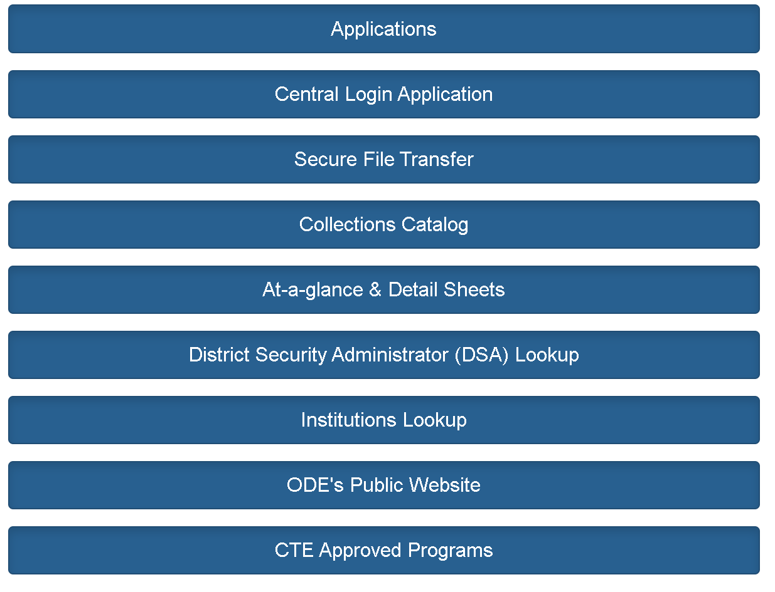
Accessing Achievement Data Insight
Secure application for accessing and validating student- and staff-level data through the District website
Tabs or scroll down and click

Slide 17
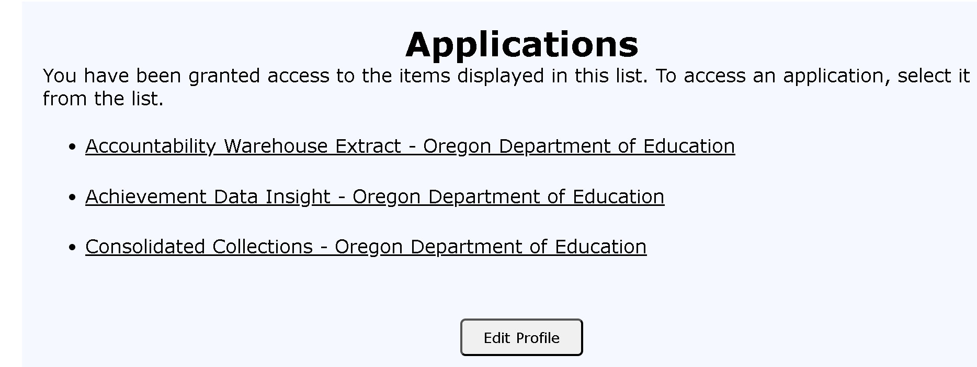
Accessing Achievement Data Insight, part 2

Slide 18
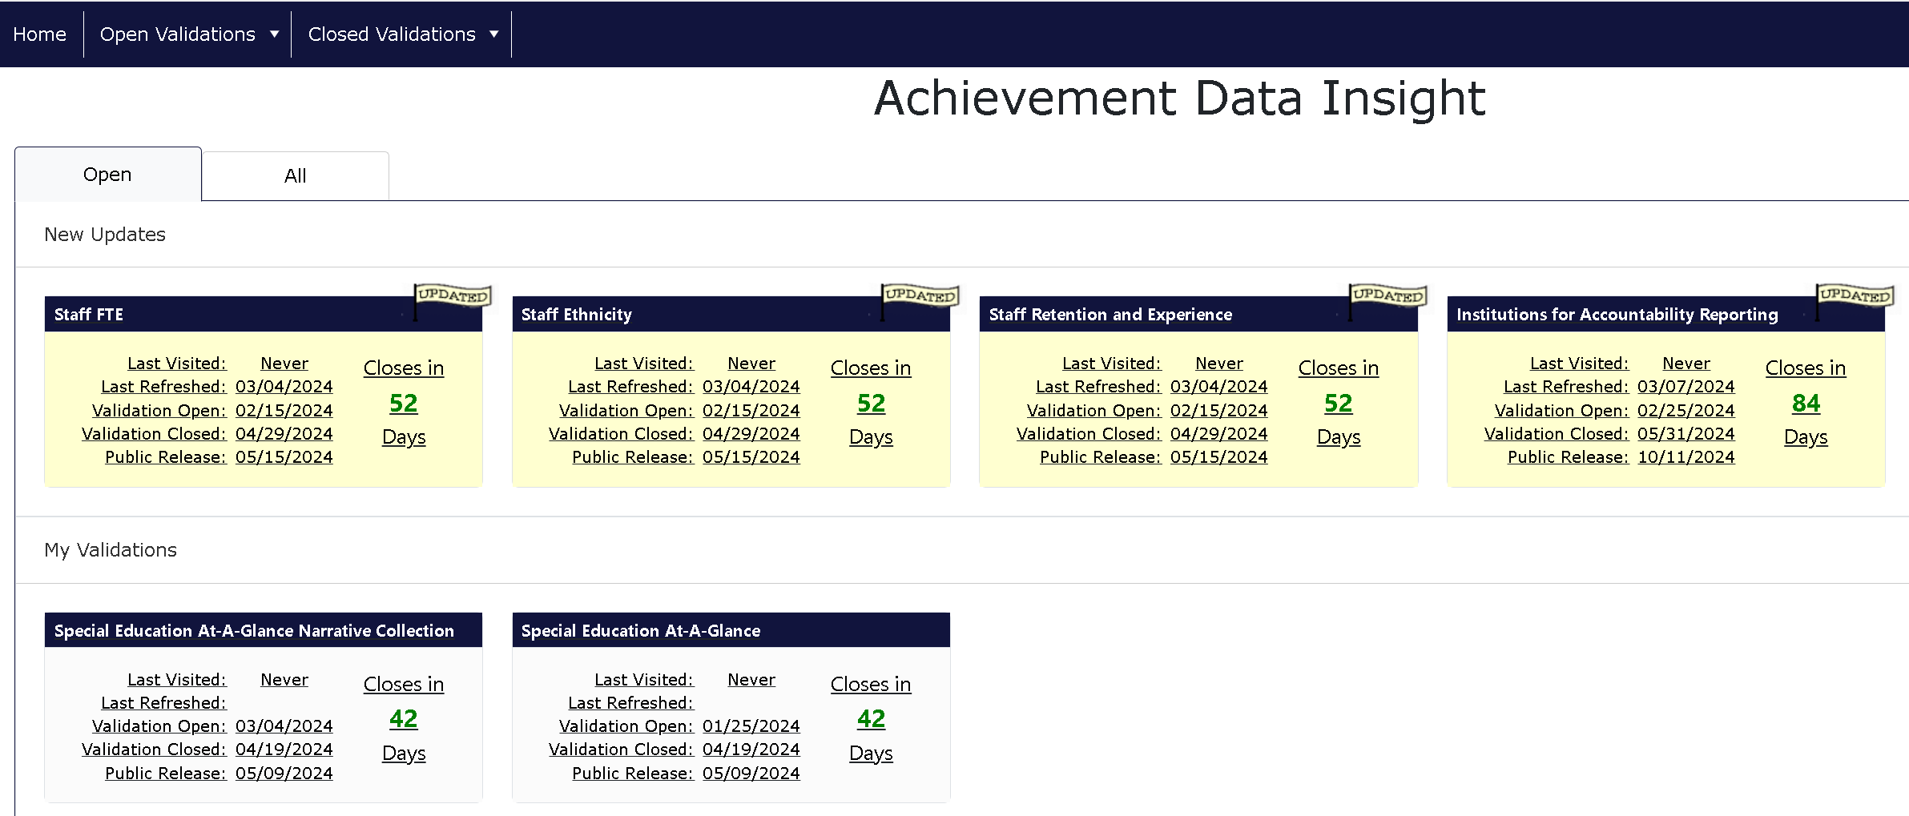
Open Tab: opens as default

Slide 19
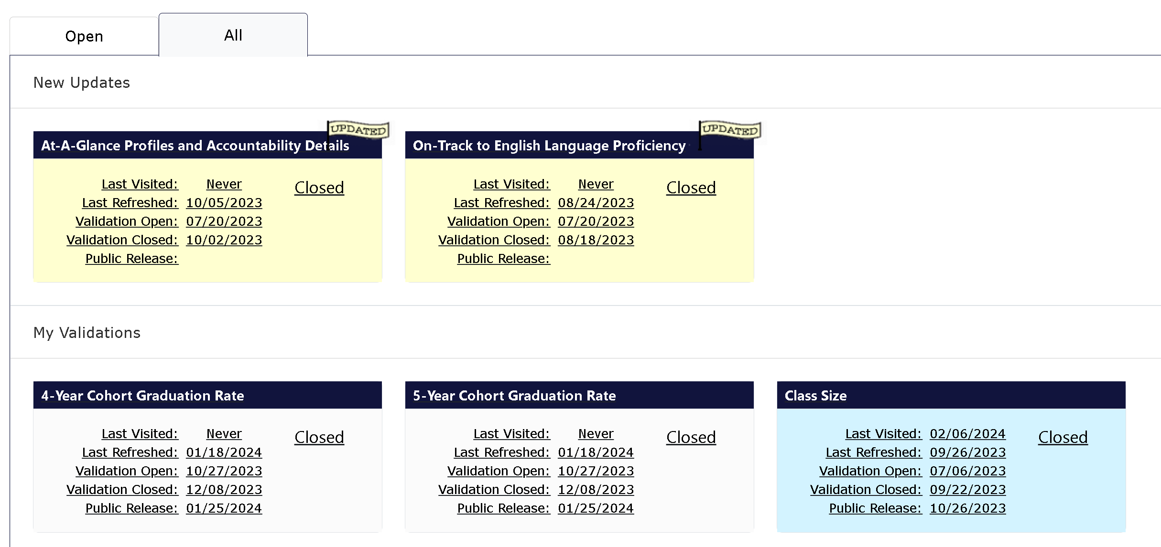
All Tab
Notes:
The All Tab is the other choice when you open ADI. This tab will list all validations open and closed. Class Size is blue because my cursor was hovering over when I made the screenshot. The new updates are again at the top. Next down is “My validations.” Near to the bottom of the scroll are the “No Permissions” and “Archived” validations and collections. I will come back to those last two in a moment.

Slide 20
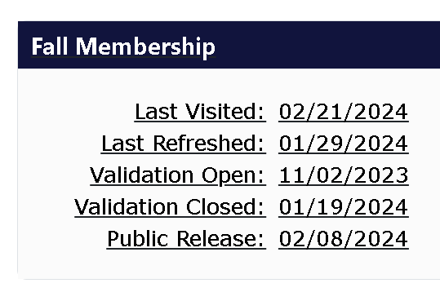
Anatomy of a Tile
Title of the Validation
Date the current user last opened this tile
Date the tile refreshed
(Not the same as the Data As-of Date)

Slide 21
Anatomy of a Tile, continued
Important: Assume all data in the ADI are embargoed until the public release date.
After the public release date, be sure to apply appropriate suppression before sharing any data from ADI
Date the data will be published

Slide 22
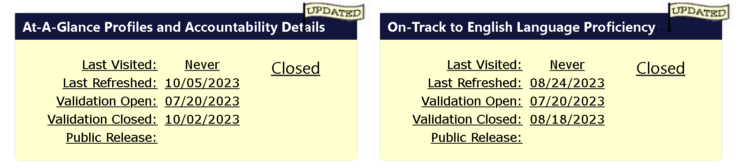
Updated Tiles
Tiles will display an “Updated” flag icon if they have refreshed since the last time you visited.
The flag icon will disappear if you click on the tile to open it, or if the public release date has passed.
Many validations have a “last refresh” after the close of the validation; check back for closed validations under the ALL tab.

Slide 23
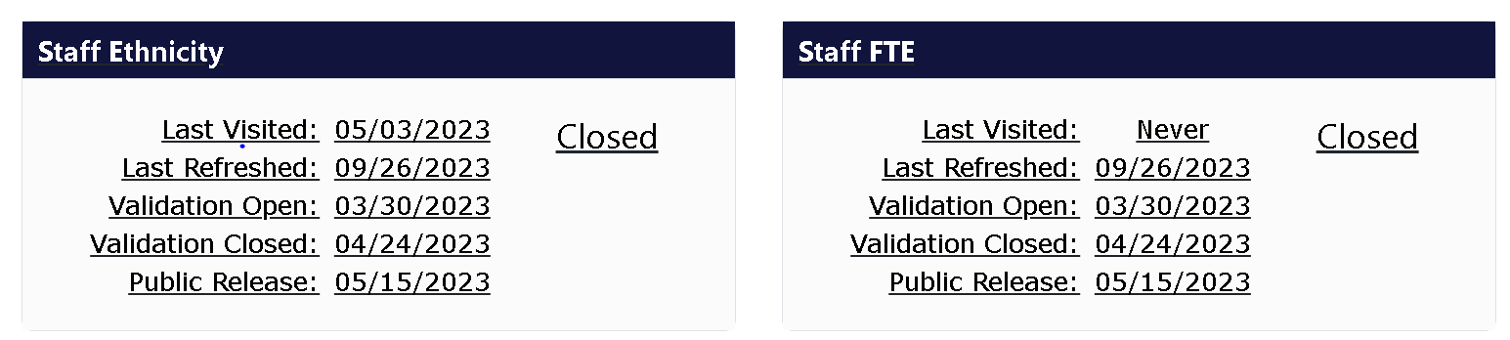
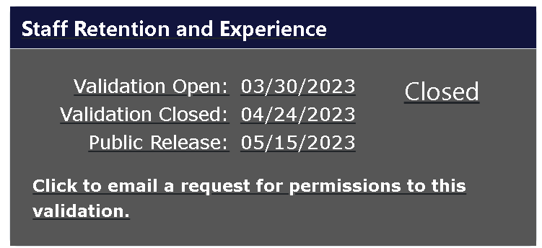
Another validation sections example

Slide 24
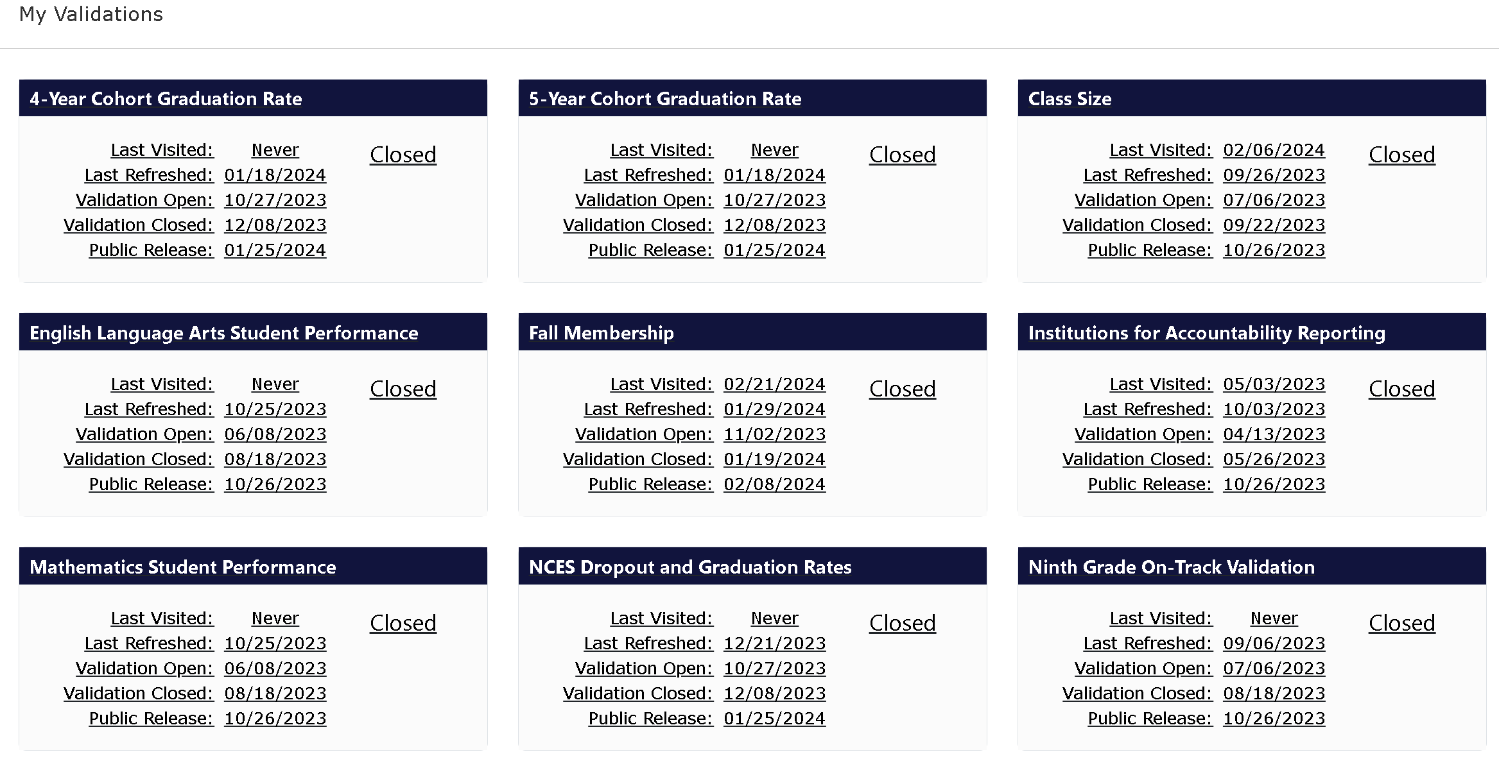
My Validations: Shows all tiles that have not had updates since you last viewed them
Contains all other validations tiles to which you have permissions.
Can be listed under Open or All depending on what validations are open and your permissions
Never (Last Visited) applies to the year shown

Slide 25
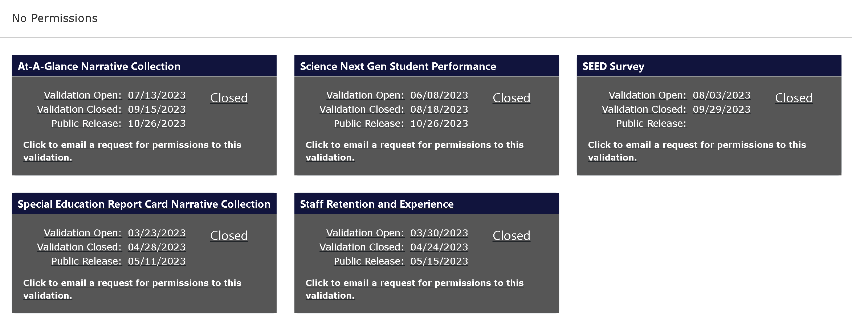
No Permissions Section
Appears below “My Validations” at the bottom of the “Open” tab or near the bottom of the “All” tab
Shaded dark gray

Slide 26
Permissions
Permissions are granted on a per-validation basis. If you see a tile that you need permissions to, contact your DSA.
Clicking on a tile you don’t have access to will generate an email to your DSA, instead of opening the validation.
Organizing tiles without permissions at the bottom of the display keeps them out your way.

Slide 27
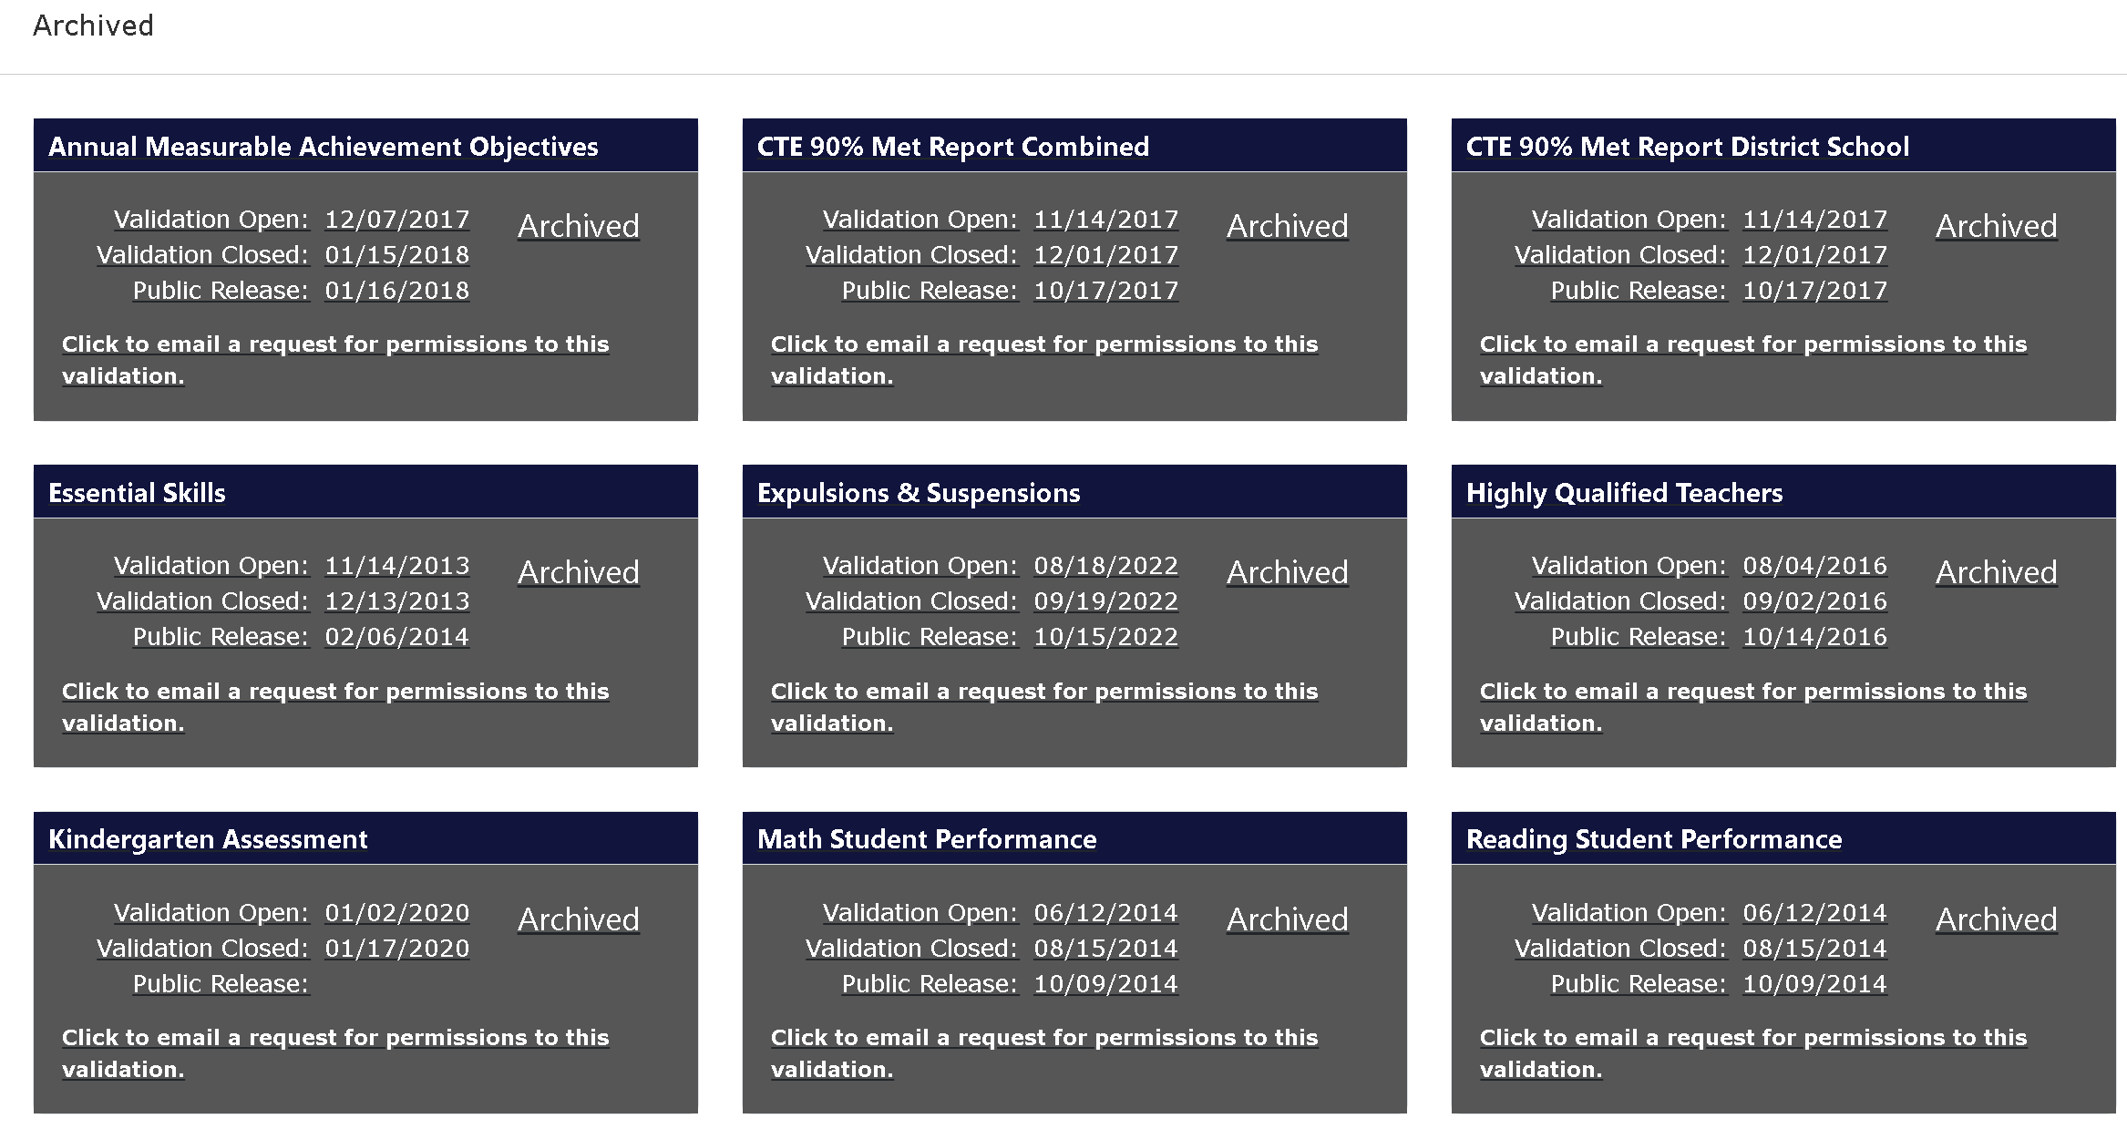
Archived Validations
Appear at the bottom of the “All” tab
Also shaded dark gray
The data in these validations are still available if you have permission, but ODE does not plan to open or update them again

Slide 28
Inside ADI Validations
Click on a tile to open the validation display
Most validations have two tabs:
Summary: aggregate data displayed
Detail: record level data displayed (one record per student, staff member, class)
Some validations have different configurations (example: At-A-Glance just has downloadable PDFs)

Slide 29
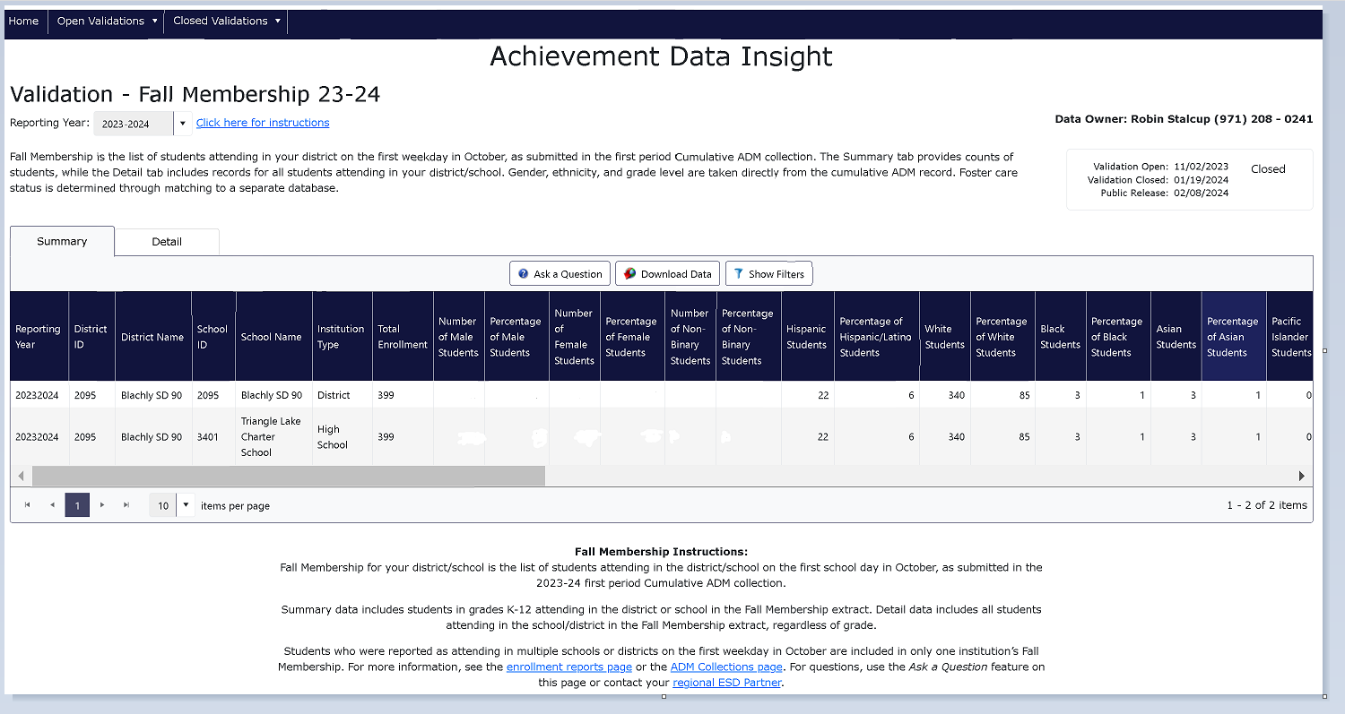
ADI Interface

Slide 30
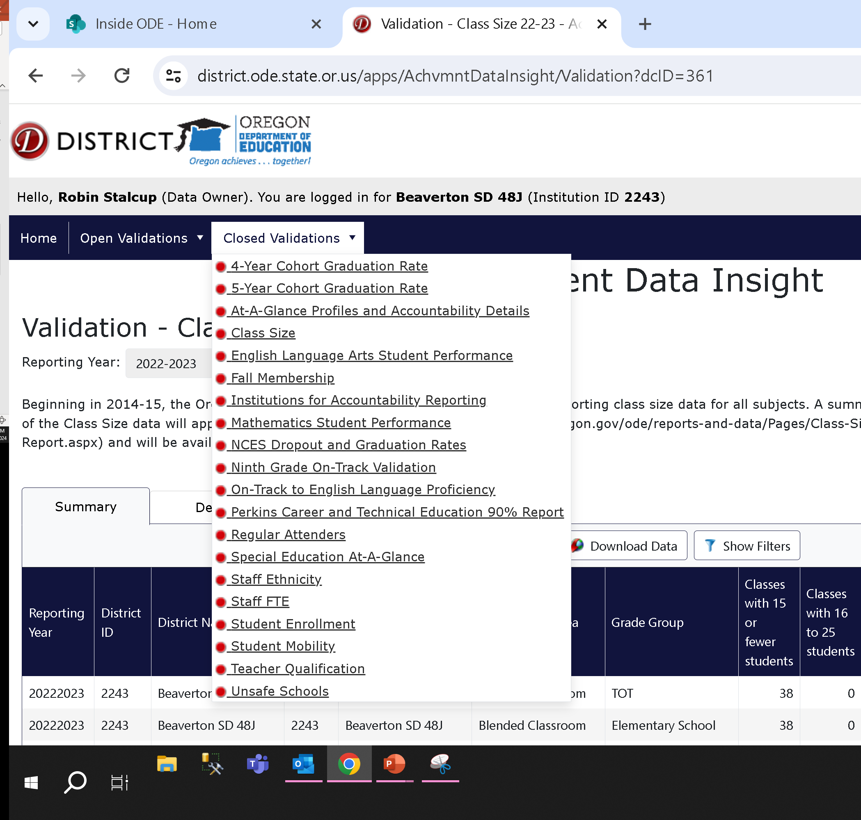
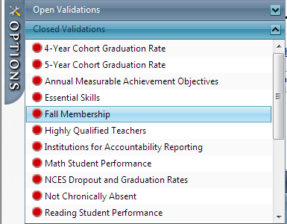
Options Tab is Reformatted as top left tabs
Old look to the left side of viewer

Slide 31
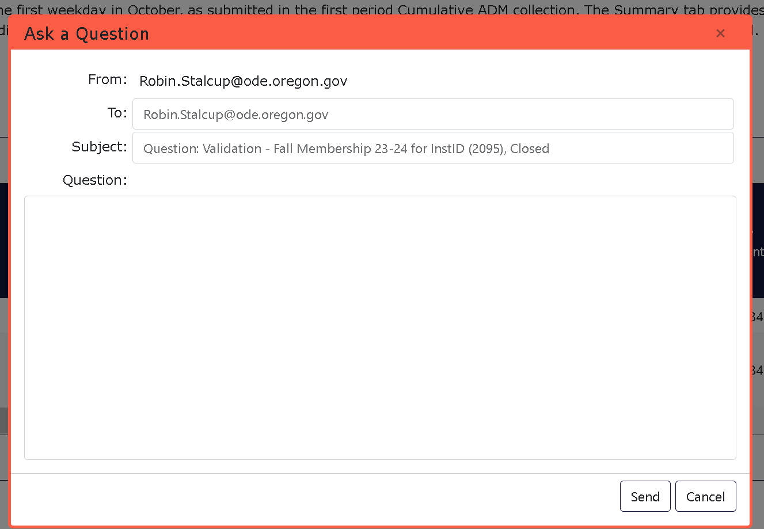
Ask a Question
Sends unsecure email to the Data Owner and a shared inbox. Do not send PII, only SSID.
Frame: Red when validation is closed, Green when it is open
Validations have different data owners, so make sure you are asking your question in the right place

Slide 32
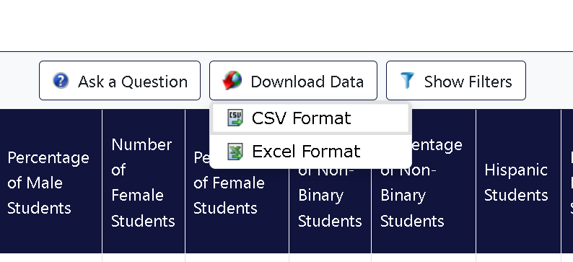
Download Data

Slide 33
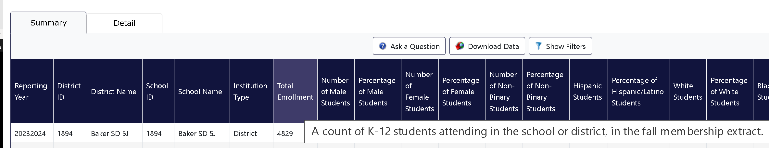
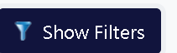

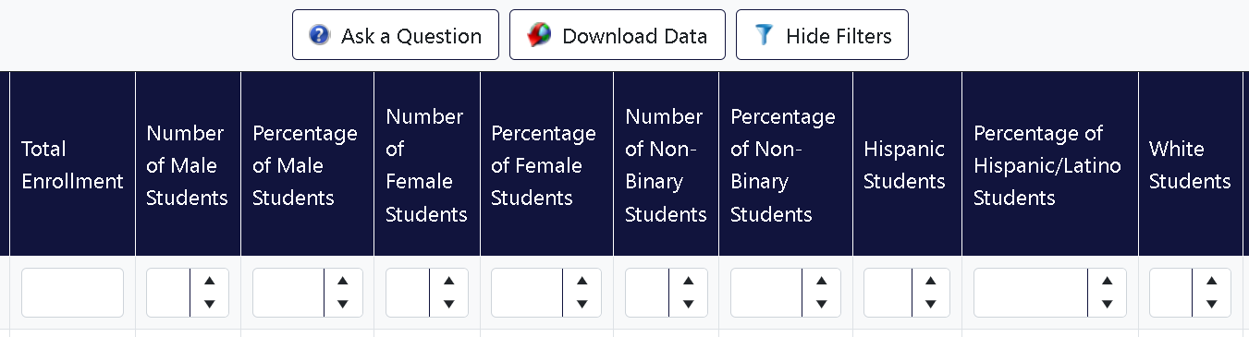
Column Headers
Hover over

Slide 34
Detail Tab
Same features as the summary tab
Important: What you see here is secure and may contain personally identifiable information
Keep your data secure

Slide 35
Here to Help: Regional ESD Partners for Accountability and Collections Support
Karen Brown Smith 1-800-706-4447 x3124
karen.brown@imesd.k12.or.us
Peter Campbell 1-800-706-4447 x 3203
peter.campbell@imesd.k12.or.us

